Slide 1

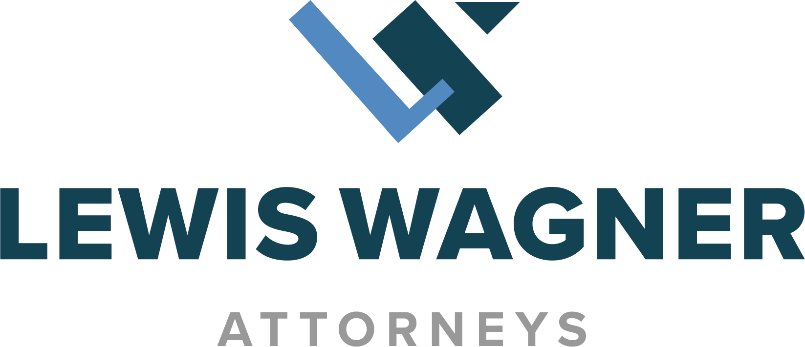
Considerations in Responding to Time Limited Demands
And Policy Limits Demands
John C. Trimble
Lewis Wagner, LP
Indianapolis, IN
ICDA Annual Meeting & Seminar
Des Moines, Iowa

Slide 2

Introduction
Time limited demand defined:
A time limited demand is any offer to settle a claim for personal or bodily injury or wrongful death made by or on behalf of a claimant to a tortfeasor with a liability insurance policy for purposes of settling a claim against the tortfeasor within the insurer’s policy limits, by which the terms must be accepted within a specified period of time.
Revised Statutes of Mo 537.058

Slide 3
Why is a Time Limited Demand Important?
An insurer may be liable for failure to accept a TLD:
  Failure to use reasonable care under the circumstances, See e.g. G.A. Stowers Furniture Co. v. American Indem. Co. 15 SW 2d 544, (Tex Comm’n App 1929)
  Breach of the duty of Good Faith and Fair Dealing, See e.g. Ganaway v. Shelter Mut. Ins. Co, 795 SW2d,554, 556 (Mo. App. S.D. 1990) See also, Henke v Iowa Mut. Cas. Co., 97 N.W.2d 168 (Iowa 1959)
  Statutory terms, See e.g. Revised Statutes of MO Section 527.058
A lawyer may face legal liability for failure to respond properly

Slide 4
Legal Basis for an Insurer’s potential liability
The right and duty to settle derives from the express policy terms that give the insurer the exclusive right and duty to investigate, defend the claim, and settle it.
The policy prohibits the insured from making a voluntary payment or settlement without the insurer’s consent.

Slide 5
A Lawyer’s Potential Roles in the Response to a Time Limited Demand
Defense Counsel
Coverage/Bad Faith Counsel
Personal or Corporate Counsel for the Insured
In House/Corporate Counsel for the Insurer

Slide 6
A Word About the Tripartite Relationship
To whom do you owe a legal duty?
Your legal duties vary from state to state, so you must know the state law in which the claim is being handled.
There is potential legal liability for a lawyer who does not know and properly recognize to whom the duty is owed.

Slide 7
Attorney Client Privilege: Why it is Important?
In subsequent extra-contractual litigation, the communications of defense counsel, coverage counsel, and the insurer will be demanded in discovery.
Defense counsel and insurance company files will be demanded.
The protection of communications is exceptionally critical, and far too many lawyers forget about whether their communications will be discoverable.
Lawyers who have violated the tripartite relationship may also face liability.

Slide 8
Typical Elements of a Time Limited Demand
The claim must be within the scope of coverage.
Demand must be within the policy limits.
The terms of the demand are such that a reasonable insurer would accept them in light of the risk of exposure to the insured.
The demand must offer to release or protect the insured for an amount that is at or less than limits.
There may be non-monetary terms that must also be accepted.
There must be a finite time by which the demand is accepted.

Slide 9
A Few Things to Consider with Respect to the Reasonableness of the Time Limited Demand
The timing of the demand (pre-suit, in suit, in trial).
The length of time to respond.
The strength of the Plaintiff’s liability claim.
The seriousness of Plaintiff’s damage claim.
The status of investigation and discovery.
The number of known and unknown claimants competing for the available policy limits.
The insured’s position with respect to the demand and whether the insured will agree to the non-monetary terms.

Slide 10
Responding to a Time Limited Demand
Treat it urgently!
Anticipate it and be ready before it arrives. (Be aware of a growing “affirmative duty to offer” before a TLD is even made!)
Defense counsel be ready and immediately get the demand to the insurer and the insured. Explain the circumstances to the insured.
All counsel and the insurer must be sure to document their files as clearly as possible for their reasons for their response to the demand.
If you need more time (and it is not your fault that you are not ready to respond), ask for more time, and explain why.

Slide 11

NEVER Ignore or Fail to Respond to a Time Limited Demand

Slide 12
Exhaustion of Limits: Options
“First in time, first in right.”
Texas Farmers Ins. v. Soriano, 881 SW2d 312 (Tex 1994)
“Purposeful intent to settle as many as possible.”
  DeMarco v. Travelers Ins. Co., 26 A2d 585, (R.I. 2011)
Largest exposure first
Pro Rata offers
Interpleader that names all potentially interested parties and lienholders
Mediation
(Resource: DRI-For The Defense, March 2013, “Exhausting Policy Limits When Settling Less Than All Lawsuits”)

Slide 13
Miscellaneous Considerations for Responding to a TLD
Who has the settlement authority…the Claims side or the Coverage/Bad Faith side? (This assumes split files.)
How do the folks on the Coverage/Bad Faith side communicate with the folks on the Claims side and still protect privileges?
What are the considerations when there is a significant coverage issue? (You know the claim is worth limits but there is no coverage).
Who should respond to the demand? Insurer? Defense counsel? Coverage/Bad Faith Counsel?
How do you deal with unknown or unasserted claims?
How do you deal with multiple insureds, multiple defense counsel, or an additional insured?

Slide 14
Typical Scenario: How Do You Approach It?
You have a serious occurrence with either deaths or multiple severe injuries. Some of the injured are children. Some of the victims left the scene or cannot yet be identified. Plaintiff counsel, Jane Shark, sends a pre-suit demand to the insurer for policy limits on behalf of her client who clearly has a massive injury.
And, there are coverage issues because of lack of permission of the driver, or a liquor liability exclusion, or a professional liability exclusion, or a sexual acts exclusion.

Slide 15
Some Rules of Thumb for Responding
Remember to send a prompt and transparent Reservation of Rights letter to the insured with respect to limits and coverage defenses.
Split the file within the insurance company.
Hire Defense Counsel and Coverage/Bad Faith counsel from the start.
Give immediate thought to preservation of privileges.
Begin to undertake an urgent investigation to learn liability facts, assess damages, and identify victims so you will be ready for the demand.
Keep the insured advised as you learn about the severity.
Consider a very early Interpleader and/or Declaratory Judgment action.

Slide 16


Good Luck!

Slide 17


1411 Roosevelt Avenue, Suite 102
Indianapolis, Indiana, 46201
317.237.0500
E-MAIL
jtrimble@lewiswagner.com

