Slide 1

2023 LEGISLATIVE SESSION

Slide 2
LEGISLATIVE COMPOSITION
House 64R – 36D
Senate 34R – 16D

Slide 3
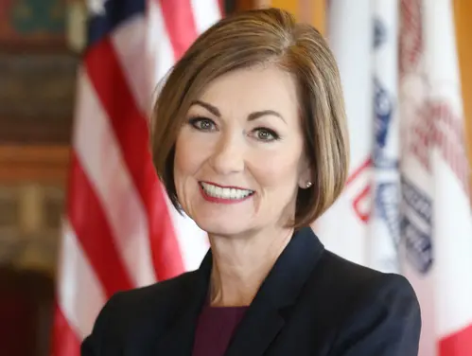
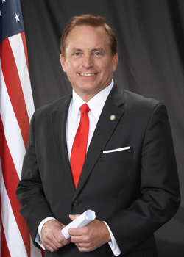
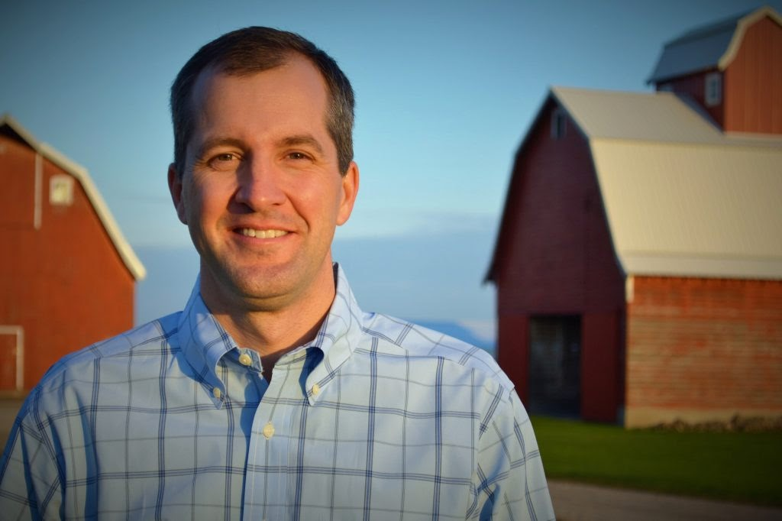
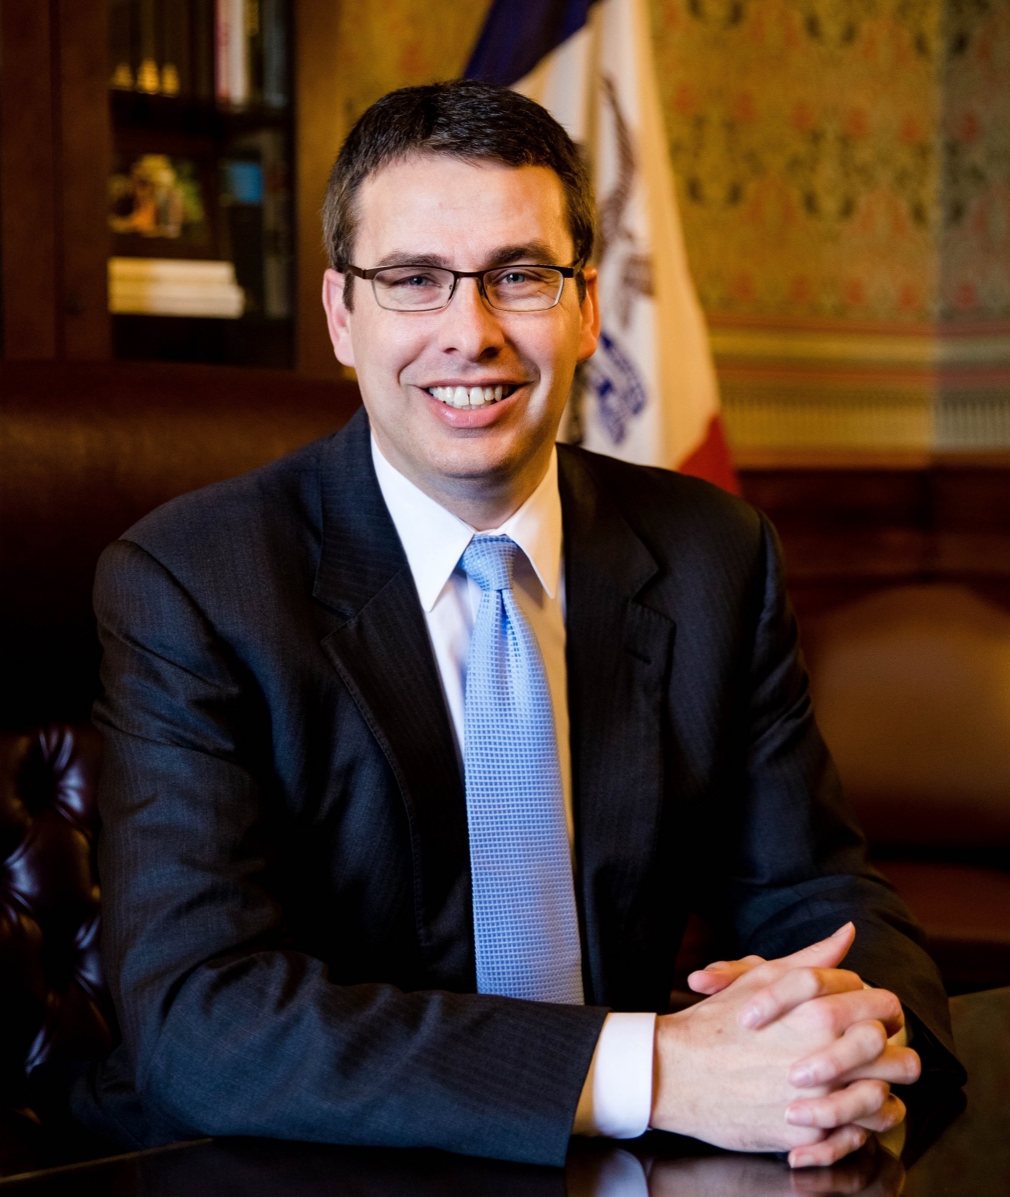
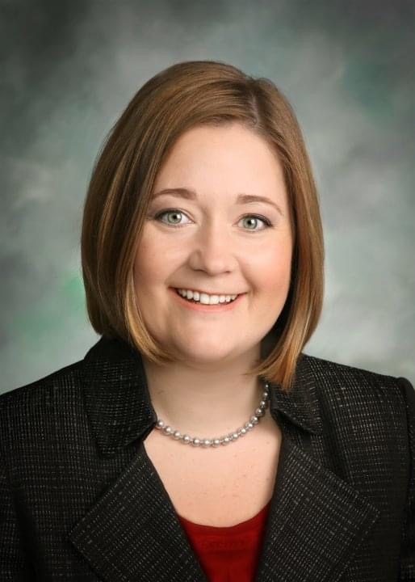
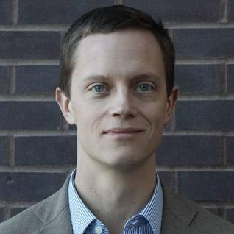
Statewide Offices
Governor Reynolds - R
Sec of State Pate - R
Sec of Agriculture Naig - R
Sec Treasury Smith - R
Attorney Gen. Bird - R
Auditor of State Sand - D

Slide 4
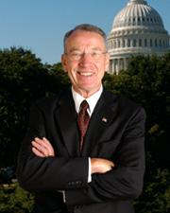
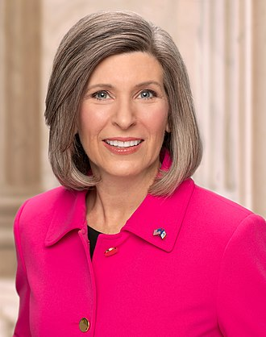
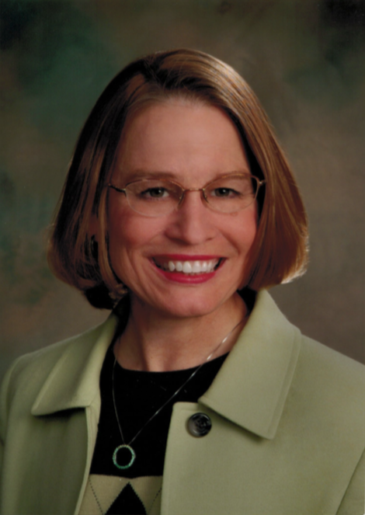
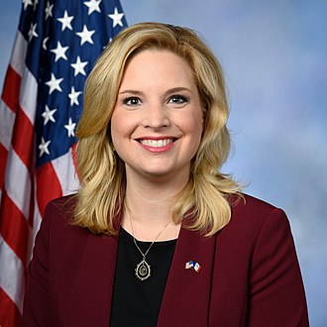
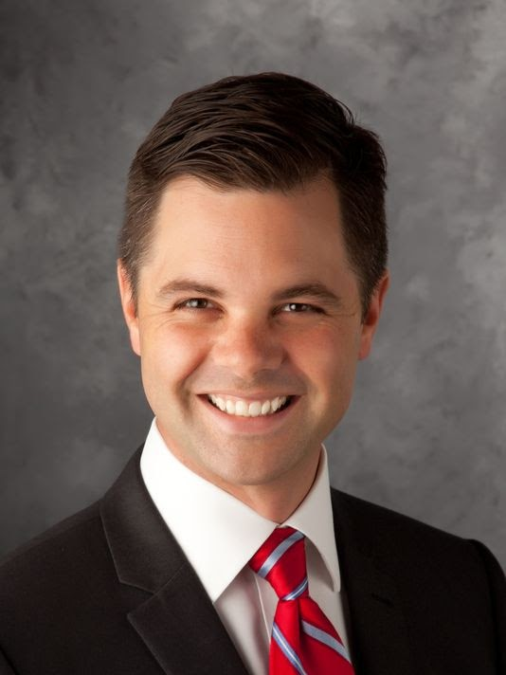
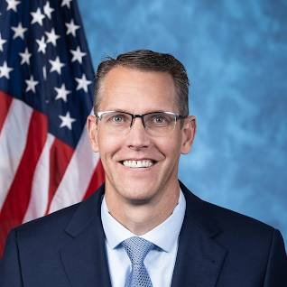
Congressional Delegation
Sen. Grassley
Sen. Ernst
Rep. Miller-Meeks
Rep. Hinson
Rep. Nunn
Rep. Feenstra

Slide 5
Active Party Registration
Republican – 39.5%
Democrat – 31.9%
No Party – 27.8%
Other – 0.8%

Slide 6
2020 Session – Major Legislation
Education Savings Accounts
Medical Malpractice Reform – Noneconomic Damages Caps
Government Reorganization – Consolidated Agencies from 37-16
Property Tax Reform

Slide 7
Tort Reform
Medical Malpractice – HF 161
Commercial Truck – SF 228
$1M cap on noneconomic damages
$2M cap if suit includes a hospital
Caps increase 2.1% annually beginning Jan. 1, 2028
Punitive damages awards all go to claimant if against a healthcare provider
Childcare not included as noneconomic damages
Caps noneconomic damages at $5 mil
Allows for a list of exceptions
Negligent hiring adjudged as Respondeat Superior if employer admits employee relationship and course and scope of employment
Commercial vehicle does not include common carriers or those engaged primarily in the transportation of passengers

Slide 8
2024 Legislative Priorities?
More individual income tax reductions
Election year
2023 session heavy lifting – Governor priorities
  School choice
  Medical malpractice noneconomic damages caps
  Government reorganization
Look for a lot of smaller rank and file bills to get consideration

Slide 9

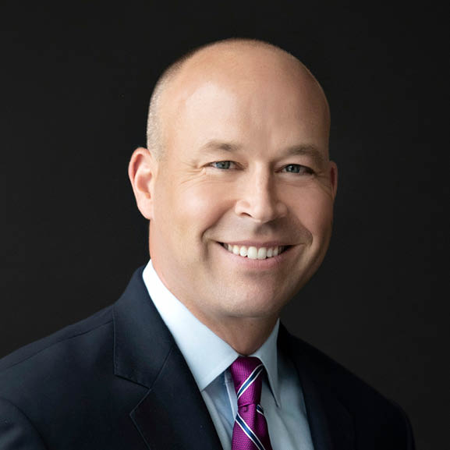
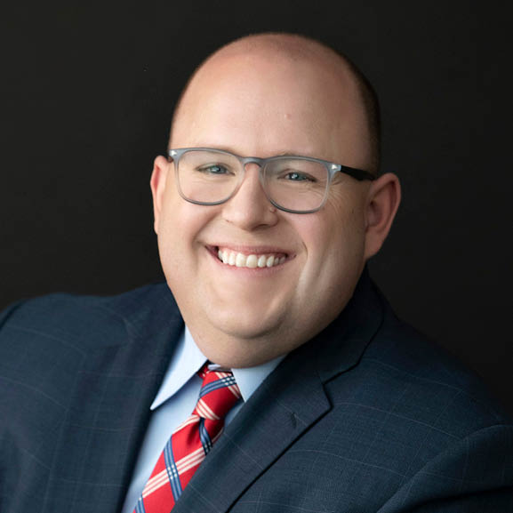
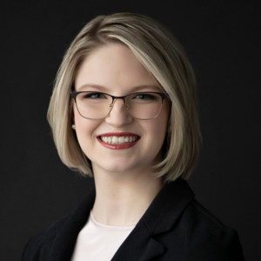
Brad Epperly
Dustin Miller
Casey Nickel

