Slide 1
The Disciplinary Cases You Don’t Read
Tara van Brederode, Director
Attorney Disciplinary Board
3.5 years of cases March 2020-August 2023

Slide 2


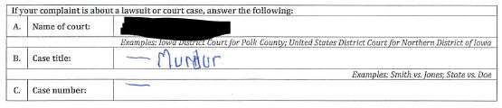
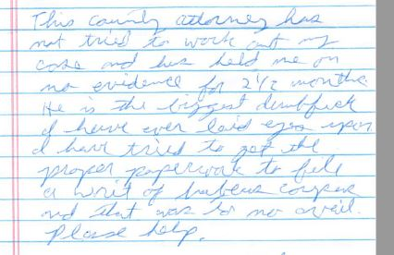
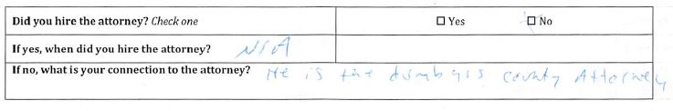
You’ve Got Mail!

Slide 3
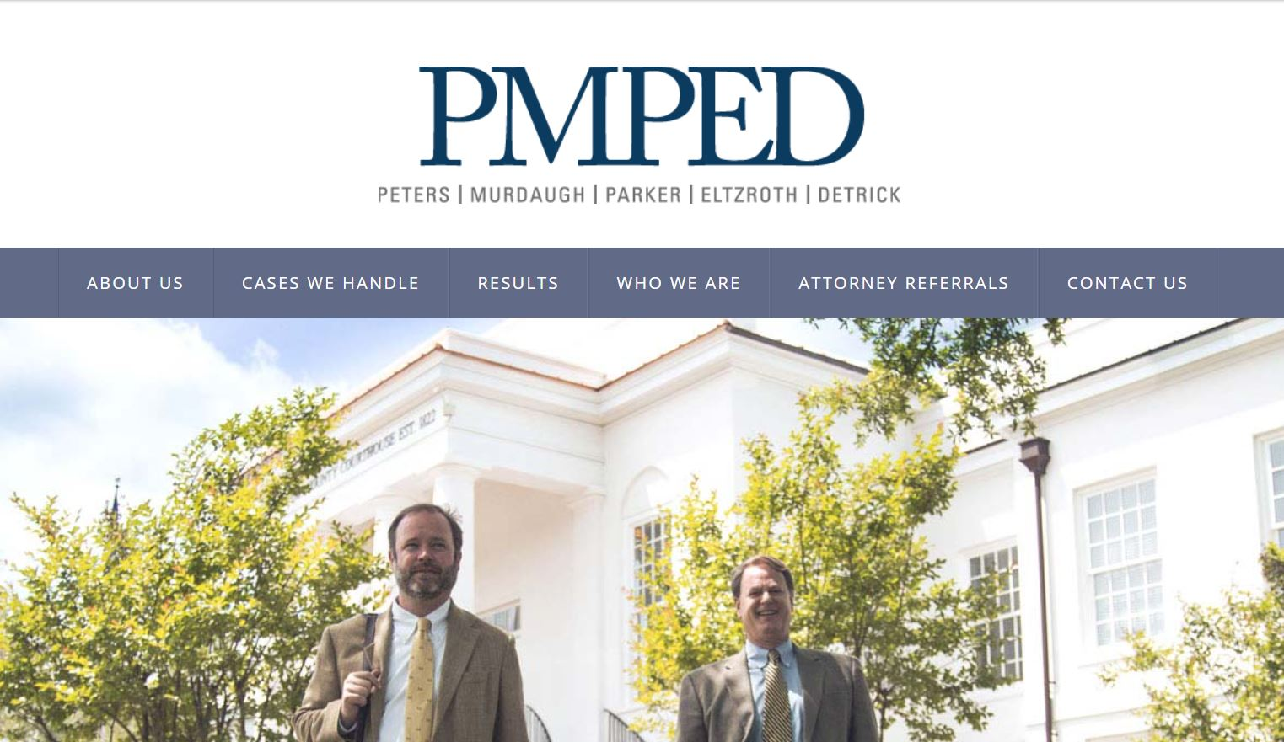
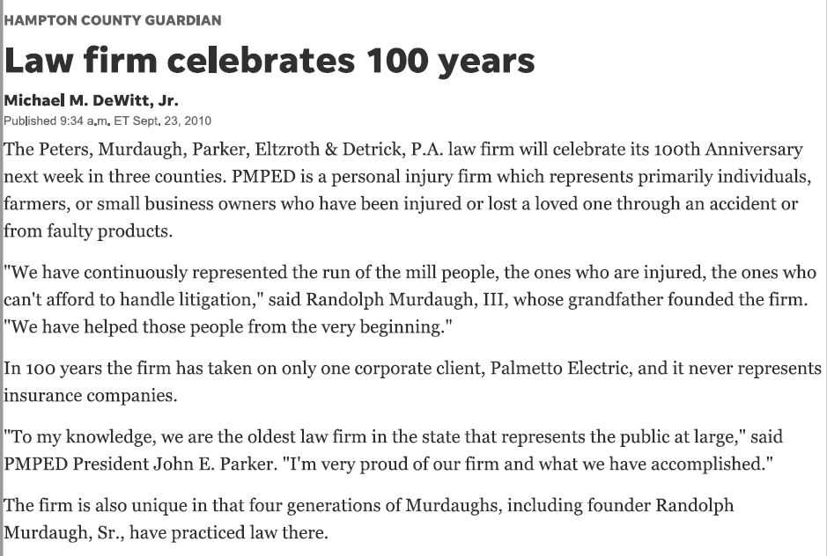
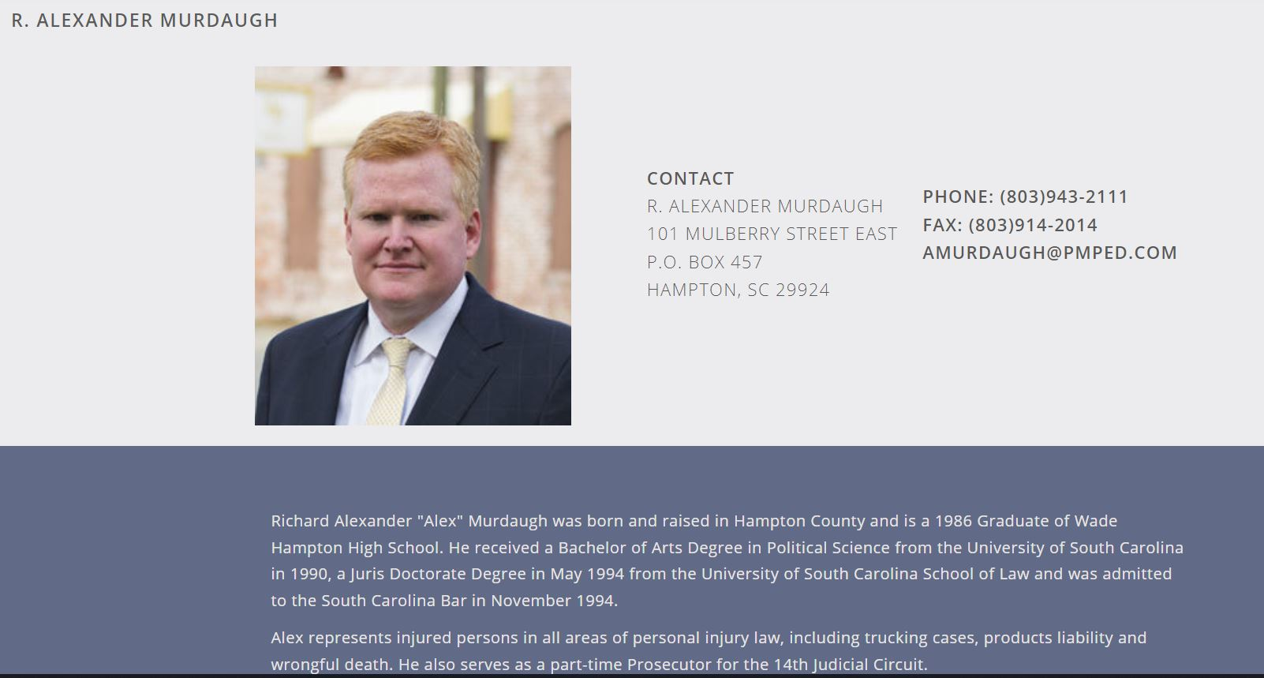

Slide 4
Internal Board staff
Director of Attorney Discipline
(reports to the head of OPR)
4 prosecutors
2 paralegals
2 full-time investigators
Volunteer Board appointed by Supreme Court (3-year terms; can renew once)
Nine lawyers
Three laypersons
Iowa Supreme Court Attorney Disciplinary Board

Slide 5
What Rules and Procedures Govern?
Iowa Rules of Professional Conduct
Adopted by Iowa Supreme Court in 2005 (replacing older disciplinary rules)
Substantially the same as ABA Model Rules of Professional Conduct
Disciplinary system is created and overseen by Iowa Supreme Court
Prosecutors / investigators = Attorney Disciplinary Board
Reviews, opens, investigates ~350 complaints each year
If public discipline is sought (particularly a suspension or revocation, but also public reprimand if the respondent attorney takes exception to a proposed/draft version), case may be assigned to staff or outside counsel to be prosecuted
“Trial Court” = Grievance Commission
Hears disciplinary matters in panel of 5 (4 lawyers + 1 layperson)
Makes findings of facts, conclusions regarding rule violations
Submits recommendation for discipline to the Supreme Court (this is the first thing that becomes public!)
Supreme Court reviews de novo and issues all public discipline in the form of an order
Attorneys’ public disciplinary histories may be viewed on IA Court Commissions website
Notes:
Tara

Slide 6

Who May Complain?
Complaints from virtually anyone
Most complaints arise out of family law and criminal matters
No statute of limitations
No “standing” requirement
No self-reporting requirement (but you must report others – see Court Rule 32:8.3)
Board may initiate its own complaints
Service via certified mail to last known OPR address or by personal service

Slide 7


Must we investigate every complaint?
Iowa Court Rule 35.4(1): “upon receiving a complaint, the assistant director for attorney discipline must evaluate all information coming to his or her attention from the complaint or from any other sources* alleging attorney misconduct or incapacity. The assistant director is authorized to decline to open an investigation of a complaint if the information, if true, would not constitute misconduct or incapacity or if the complaint is facially frivolous, stale, lacking in adequate factual detail, duplicative, outside the disciplinary board’s jurisdiction, or does not otherwise reasonably warrant investigation.”
*We frequently check dockets, social media sites, news sources, and Google.
Notes:
Tara

Slide 8
Rule 8.3: REPORTING MISCONDUCT
IOWA
MODEL RULE
“(a) A lawyer who knows that another lawyer has committed a violation of the Iowa rules of professional conduct shall inform the appropriate authority.”
“(c) this rule does not require disclosure of information otherwise protected by [confidentiality rule] or information gained by a lawyer or judge while participating in an approved [lawyer assistance program/LAP].”
(a) is the same BUT includes language “raises a substantial question as to that lawyer’s honesty, trustworthiness[,] or fitness as a lawyer in other respects….”

Slide 9


Who, What, Where, When, How?
“Lawyer who knows”: reasonable lawyer in same circumstances
Even nonpracticing lawyers (suspended, inactive)
Non-confidential information only – not your client, not a fellow participant in a LAP
No self-reporting requirement
Even known conduct
Even impairment (physical/mental)
Within a reasonable time
May not threaten opposing counsel
  Please don’t put this in filings – or don’t file without also reporting
  Don’t use as means to disqualify (and this doesn’t automatically disqualify)
Report to ADB

Slide 10
What happens to unopened complaints?
Iowa Court Rule 35.4(5): A potential complaint declined pursuant to this rule may not be deemed a complaint for any purpose….Will not be docketed…and the disciplinary board or the respondent must not report or disclose the complaint to any person or authority for any reason.
In practice, when we don’t open a complaint:
We scan it.
We write a letter to the potential complainant explaining why we are not investigating.
We save both documents under the potential complainant’s name in our case-management system (because we have lots of repeat complainants).
We do not index the potential complaint to the subject attorney.
The subject attorney never knows.
Notes:
Tara

Slide 12
How many respondents?
In 2022:
  334 File Closures = 274 Respondents
  396 Files Opened = 335 Respondents
  125 Lawyers violated the Rules (including private admonitions)
Notes:
Tara

Slide 13
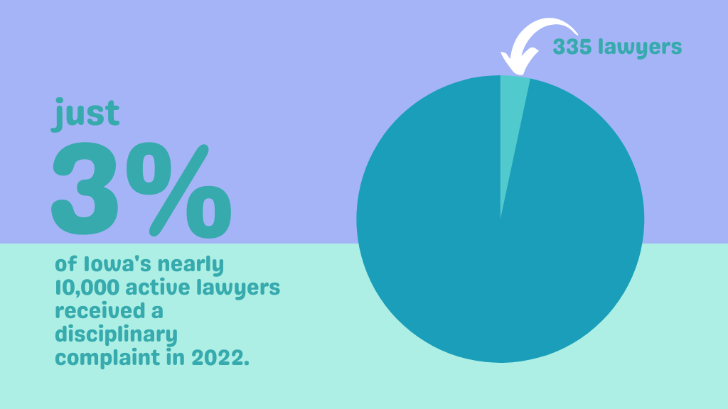

Slide 14
Alleged Misconduct

Slide 15
Iowa Rule of Professional Conduct 32:8.4 Misconduct
It is professional misconduct for a lawyer to:
…
(b) commit a criminal act that reflects adversely on the lawyer's honesty, trustworthiness, or fitness as a lawyer in other respects;
(c) engage in conduct involving dishonesty, fraud, deceit, or misrepresentation;
(d) engage in conduct that is prejudicial to the administration of justice;
…
(g) engage in sexual harassment or other unlawful discrimination in the practice of law or knowingly permit staff or agents subject to the lawyer's direction and control to do so.

Slide 16
Area of Law – Matters closed in 2022 | Number of Matters | Percentage
Criminal | 96 | 28.7%
Law Practice Management / Trust Acct. | 53 | 15.9%
Family Law | 38 | 11.4%
Civil/Commercial/Consumer/Contracts | 37 | 11.1%
Probate | 23 | 6.9%
Real Estate | 13 | 3.9%
Juvenile | 12 | 3.6%
Other | 12 | 3.6%
Appellate - Criminal | 11 | 3.3%
Conduct Outside Practice | 11 | 3.3%
Personal Injury | 10 | 3.0%
Employment | 8 | 2.4%
Appellate - Juvenile | 3 | 0.9%
Immigration | 3 | 0.9%
Professional Liability | 2 | 0.6%
Disability / Work Comp / Social Sec. | 1 | 0.3%
Health Care | 1 | 0.3%
Grand Total | 313 | 100.00%
New!
“Other” includes reinstatement applications, reciprocal discipline cases,
disability cases, and assorted other matters.
New!

Slide 18
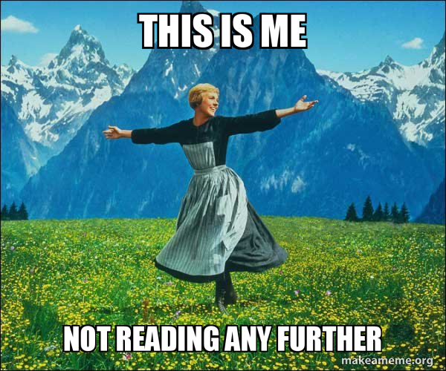
The cases you’re not reading

Slide 19
“Friday Opinions” Don’t Tell The Whole Story
The Attorney Disciplinary Board handles many more cases than you see on the Iowa Supreme Court’s Friday opinion lists
March 2020 to March 2023:
Disbarred by opinion: 2 lawyers
Suspended by opinion: 18 lawyers
Publicly reprimanded by opinion: 3 lawyers

Slide 20
24
Published Opinion Cases
March 2020 – August 2023
Disbarment / Revocation
Fischer, John Karl
Kozlik, Michael D.
Dismissed
Rhinehart, Richard Scott
Public Reprimand
Akpan, David Ebong
Ranniger, William Wayne
Tindal, Eric David
Suspended 1 Year Or More
Fisher, Scott D.
Janssen, Jeffrey Michael
Johnson, Wesley Alan
Kieffer-Garrison, Lori Jo
Meyer, Jennifer Lynn
Newport, Stephen Warren
O'Brien, Brien
Suspended 3 To 6 Months
Aeilts, Andrew Gatton
Beauvais Jr., John Philip
Daniels, Curt N.
Heggen, Bonnie J.
Watkins, Abraham K
Widdison, Harold K.
Suspended 30 Days
Marzen, Jesse Michael
Said, Michael Hocine
Willey, Bruce A.
Suspended 60 Days
Bixenman, Scott L.
Johnson, Scott

Slide 21
28
Consent Cases
March 2020 – August 2023
Disbarment on Consent
Anderson, Patrick Ryan
Den Beste, Curtis Wayne
Saunders, Lonnie Benjamin
Suspended 1 Year Or More
Cannon, Peter Sean
Rhinehart, Richard Scott
Suspended 3 To 6 Months
Barker, Bryan Joy
Capotosto, Donald H.
Kehrwald, Adam Elliot
Liu, Kylie Marie
Mez, Jay Warner
Rivera, Michelle Murphy
Steinbach, Deanna Kay
Suspended 30 Days
Bergmann, Beau Alvin
Carlstrom, Jason Thomas
Fieweger, Stephen T.
Hitchins, Kevin R.
Mauk, Matthew Alan
Scherle, Timothy Albert
Tackett, Brian Edward
Suspended 60 Days
Fenton, Joel E.
Jackson, Gerald E.
Nelson, Bradley John
Primmer, Chad Douglas
Sellers, Michael M.
Suspended 7 To 11 Months
Khowassah, Tarek A.
Zenor, Amy
Nelissen, Alexandra
Brick, Matthew

Slide 22
More Public Dispositions Without S.C. Opinions
March 2020 to
August 2023
Reciprocal discipline:
3 disbarments, 4 suspensions, 1 public reprimand
Publicly reprimanded by consent:
70 lawyers
Disability/crime/threat of harm suspensions:
13 lawyers
Reinstatements from suspension:
14+ lawyers

Slide 23
Non-Public Dispositions
March 2020 to August 2023:
  Deferrals of discipline: 30+ lawyers
  Dismissal after investigation: 400+ lawyers
  Private admonitions: 350+ lawyers
  Probate delinquencies cured: 500+ lawyers*
NOT DISCIPLINE
*Over 950 delinquent probate cases.

Slide 24
Where Are These Cases?
Opinion cases:
SC opinion list on Fridays, eventually in Westlaw/Fastcase
ALL public dispositions (including consents to discipline/most public reprimands):
Iowa Court Commissions website (iacourtcommissions.org), searchable by lawyer name or by year if you want to see all recent ones
Non-public dispositions:
Safely and confidentially kept in the ADB database

Slide 25
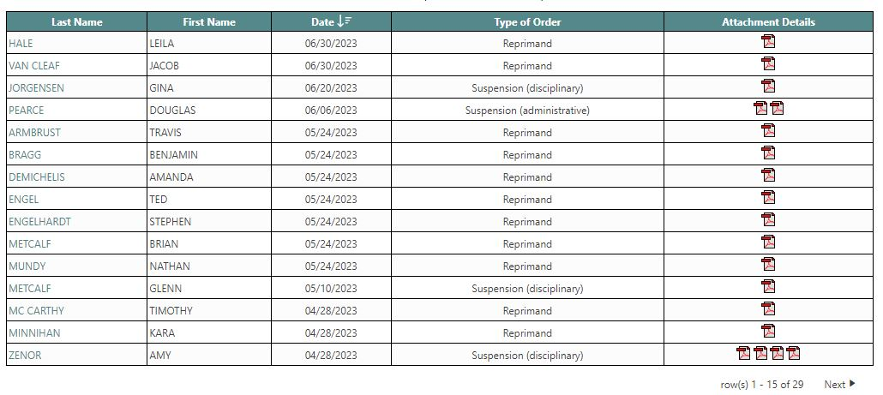

Slide 26
Public Reprimands
Instructive and educational. What a shame that most lawyers don’t read them….

Slide 27
How Do Public Reprimands
Get Processed?
The Board determines that a lawyer should be publicly reprimanded for ethical misconduct.
  Either the violation is severe enough, or the lawyer has previously been warned (“admonished”) about the same type of violation.
The Board’s director sends the lawyer a public reprimand letter.
  If the lawyer challenges it, but the Board believes that a PR is the right disposition, the lawyer gets a trial.
  If the lawyer doesn’t challenge it, the PR gets sent to the Iowa Supreme Court for its consideration.
    The Court may reject the PR and send it back to the Board for further handling (either too big or too little?)
    The Court may enter an order approving the PR as drafted, and the PR+order are now public.
56 lawyers were publicly reprimanded without published opinion from March 2020 to March 2023.
Average consideration time by Supreme Court for those reprimands: 38.5 days

Slide 28
Consents to Discipline
A new emphasis at the Attorney Disciplinary Board.

Slide 29
Are There More Consents (Recently)?
Yes.
January 2016-January 2020 (4 years): 8 consents to discipline
March 2020-March 2023: 25 consents to discipline

Slide 30
Why Pursue Consents to Discipline?
Much faster and more protective of the public.
Grievance Commission process typically takes 1 year or more (average for 23 recent prosecutions was 498 days from filing of complaint with the Grievance Commission to the Supreme Court’s disposition order).
Even with expedited timelines and the Board’s policy of resisting all continuances absent proof of emergency, trial is 60-90 days from filing, briefing takes 45-60 days after trial, the hearing panel needs 60 days to write a recommendation once briefs are submitted, the respondent then has an appeal window, the matter needs to be formally submitted to the Court even if no appeal is taken, and a Justice must write a full opinion.
Consent process takes days or weeks (average for 25 recent consents was 40 days from filing of consent & Board response to the Supreme Court’s disposition order).
Facts are often not in dispute.
Better use of Board, Grievance Commission, and Supreme Court resources.
Not every case needs a formal Iowa Supreme Court opinion (many cases resemble earlier cases).

Slide 31
How Do Consents Work?
Rule 34.16 allows “suspension or revocation on consent.”
  Lawyer files affidavit admitting that the “material facts of the alleged misconduct are true.”
  Lawyer may present mitigating factors in the affidavit.
  Lawyer consents to a “ceiling” sanction.
  Board prepares a response to the affidavit (in the form of a brief), adding caselaw, argument, and mitigating/aggravating factors and recommending a sanction.
  Usually accompanied by a confidential appendix/exhibits.
  All are filed with grievance commission clerk and forwarded directly to the court for consideration.
  Court may impose sanction up to ceiling or remand for further proceedings.

Slide 32
Why Are There More Consents?
No backlog at Board (if consent discussions fail, we will quickly prosecute the matter).
Prosecutors offer them early on and continue to discuss them with respondents/respondents’ counsel all the way up to start of formal prosecution.
Grievance Commission proceedings involve costs – counsel for respondent, transcript costs, time away from work.
Avoid the uncertainty of a contested proceeding.
COVID added an incentive to avoid trials.
Attorneys recognize that NW2d opinions come up in Google searches.

Slide 33
Some Consents to Discipline
recent
^
Criminal offenses (some with issue preclusion):
OWI (2nd or subsequent) and other alcohol-related offenses:
90 day suspension (Mez 2020, Khowassah 2020, Rivera 2021, Steinbach 2022)
30 day suspension (Zenor 2023—also disability suspension, Carlstrom 2022)
Drug offenses:
90 day suspension (Barker 2021)
Assault/OWI/Sexual Harassment:
90 day suspension (Kehrwald 2022 – also disability suspension)
Harassment:
60 day suspension (Jackson 2022)
Sexual relationship with client:
1 year suspension (Rhinehart 2021)
30 day suspension (Tackett 2022)
60 day Suspension (Nelson 2022)
90 Day suspension (Liu 2022)
Conflict of interest:
30 day suspension (Brick 2023)
Conversion:
Revocation (Den Beste 2021, Saunders 2021)
Fraud:
1 year suspension (Cannon 2021)
Revocation (Anderson 2023)
Neglect/lack of communication/lack of diligence:
120 day suspension (Capotosto 2021)
60 day suspension (Fenton 2020)
30 day suspension (Scherle 2020, Fieweger 2020, Mauk 2020, Bergmann 2023)
Nonmeritorious claims:
30 day suspension (Hitchins 2022 and see Sellers below)
Audit violations:
60 day suspension (Primmer 2021 – also diligence and confidentiality violations)
Fees:
60 day suspension (Sellers 2023; also nonmeritorious filings)

Slide 34
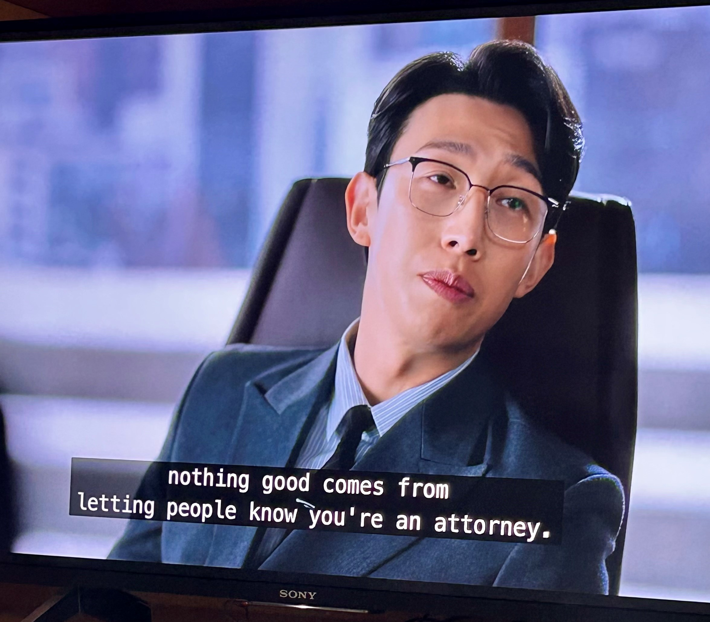
Tara M. van Brederode
Director of Attorney Discipline, Office of Professional Regulation
Administrator, Attorney Disciplinary Board
1111 East Court Avenue
Des Moines, IA 50319
515-348-4680 tara.vanbrederode@iowacourts.gov

