Slide 1


Whitaker’s
Corny
(but a-maize-ing)
Legal Quiz

Slide 2


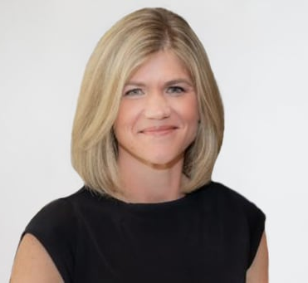

The Rules…
Loser
Winner

Slide 3
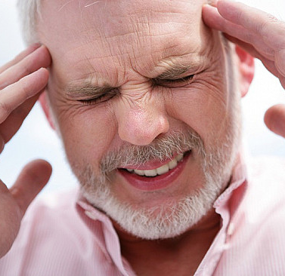
Kirlin v. Monaster
Patient involved in a motor vehicle accident
Reported symptoms: sporadic headaches, neck pain and pressure behind the eyes

Slide 4

Kirlin v. Monaster
Visits with two different family physicians
Has a head CT scan which is normal
Visits with pain management physician
Prescribed medication for his headache
Come to the ER if symptoms worsen

Slide 5
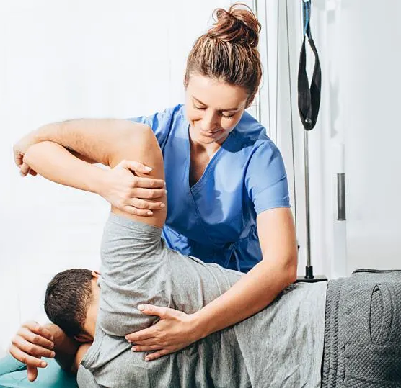
Kirlin v. Monaster
Adjustment at chiropractor: experiences stroke and is sent to Emergency Department

Slide 6
Procedural history…
First petition is filed
Non-compliant certificate of merit is served
Motion to dismiss filed
Less than a week later: voluntary dismissal without prejudice
Second petition filed
Motion for summary judgment
Case dismissed
Plaintiff’s appeal

Slide 7
“Failure to substantially comply… shall result, upon motion, in dismissal with prejudice”

Slide 8
Questions for the Court:
Whether the dismissal right under 147.140 attached upon a motion to dismiss
Would there be an exception to Plaintiff’s right to voluntarily dismiss?

Slide 9

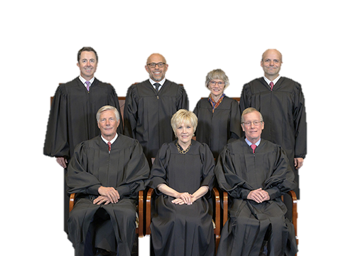
What did the Supreme Court decide?
A. Affirm the lower court’s decision
B. Reverse and remand
C. Made no decision and took a trip to the Bahamas

Slide 10
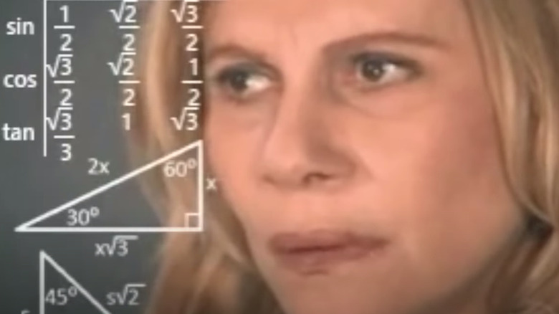
What Rule did the Plaintiff’s right to voluntarily dismiss come from?
A. Iowa Rule of Civil Procedure 1.943
B. Iowa Rule of Evidence 5.601
C. Iowa Rule of Civil Procedure 1.394

Slide 11
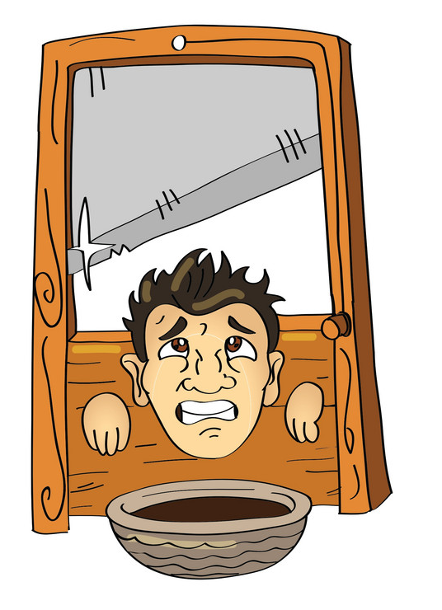

How did the Court describe the right to voluntarily dismiss?
A. Annoying but necessary
B. Self-executing and absolute
C. Powerful and formidable

Slide 12
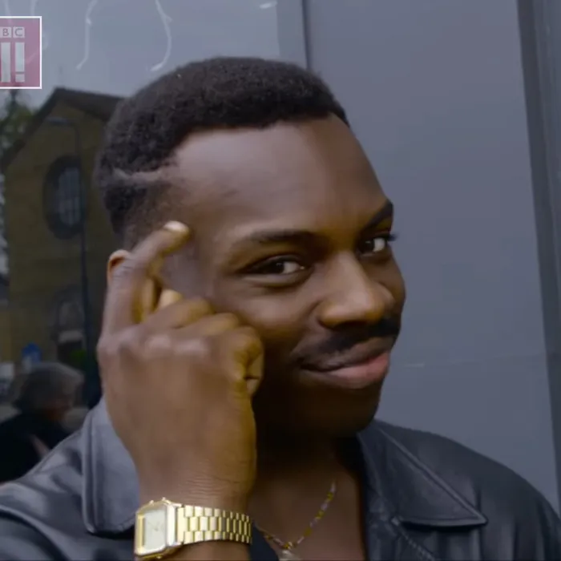
At what point in the litigation process does a party require consent from the court to voluntarily dismiss?
A. After the motion deadline has run
B. 30 days prior to trial
C. 10 days prior to trial

Slide 13
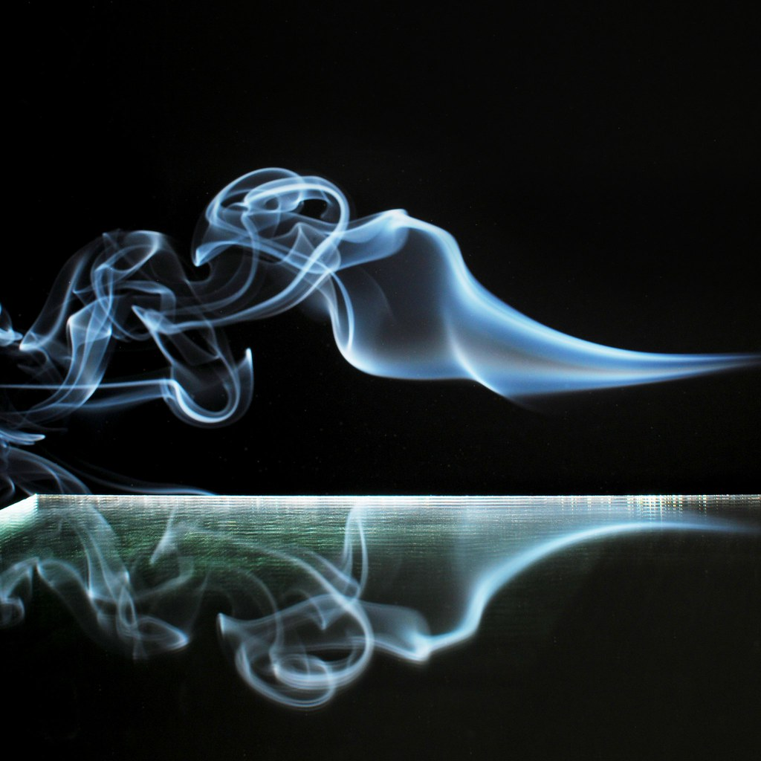
What is the effect of a voluntary dismissal?
A. It dismisses everything, with the exception of pending motions
B. It terminates the court’s jurisdiction and renders everything before unreviewable, with the exception of collateral issues
C. The court’s jurisdiction is severed and everything prior is unreviewable

Slide 14
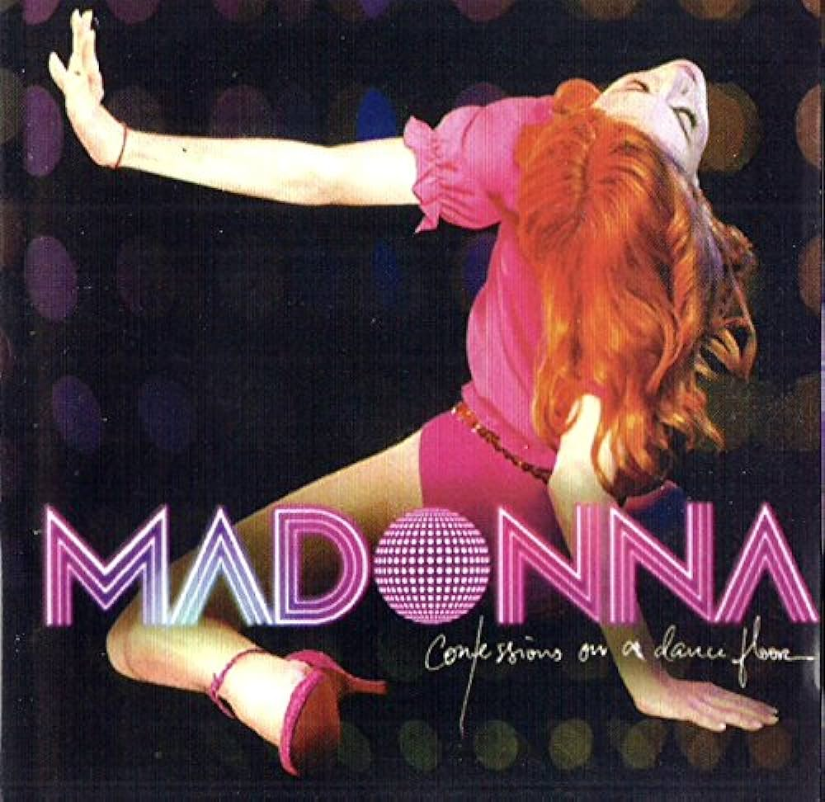
Time goes by… so slowly

Slide 15
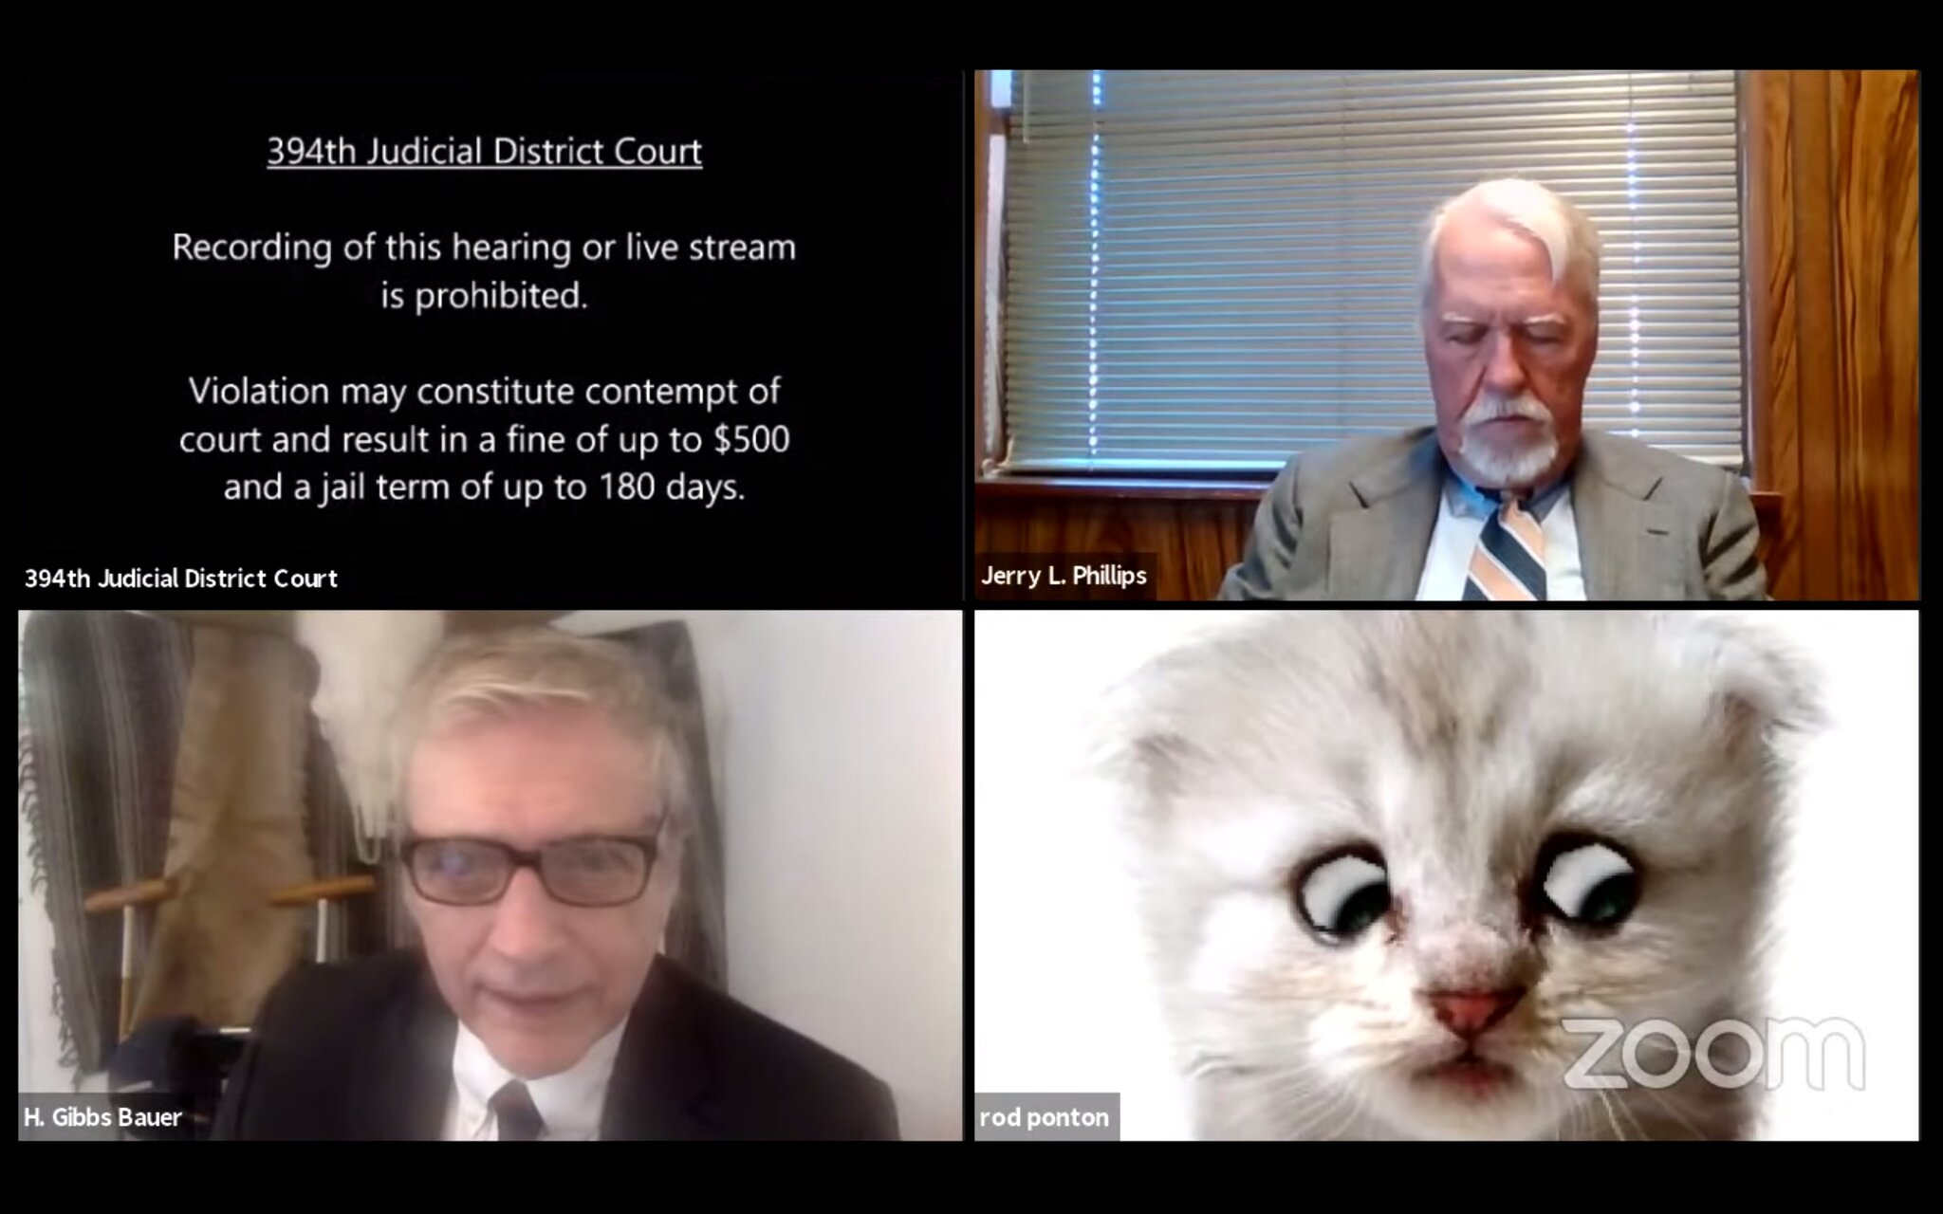
Newly Adopted Rules of Remote Procedure
Motion Content: Any party can move to have a virtual/remote hearing. It must include a certification that the moving party “has in good faith communicated or attempted to communicate with all other affected parties to determine whether the motion is unresisted, that such communication was not feasible under the circumstances, or that such communication is prohibited by prior court order.”
Court Consideration: The Court is directed to look at several factors including ability of the parties, timeliness of the motion, court facilities and type of motion.

Slide 16
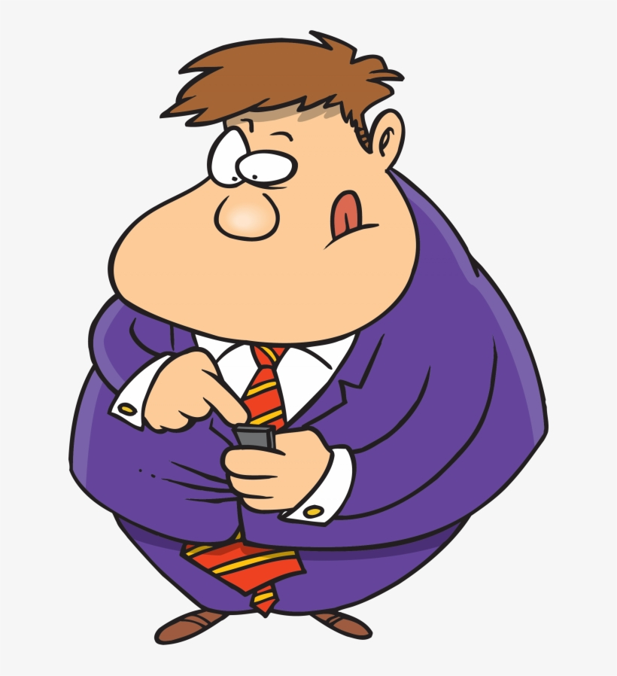
Feeback v. Swift Pork Company
What reason did Swift Pork give for terminating David Feeback in this case?
A. To make a point, David dressed as a donkey at his performance review
B. As a practical joke, David released a group of piglets at the facility
C. After a negative performance review, David texted his manager “F*CK you!”

Slide 17

What was the Plaintiff’s argument?
A. That he meant to text another person
B. That Swift Pork retaliated against him for making safety complaints
C. That swearing was common in the workplace
D. That Swift Pork had a practice of discriminating against older employees

Slide 18
Question for the court:
Should the McDonnell Douglas framework be applied on summary judgment for ICRA discrimination claims that rest on indirect evidence?

Slide 19
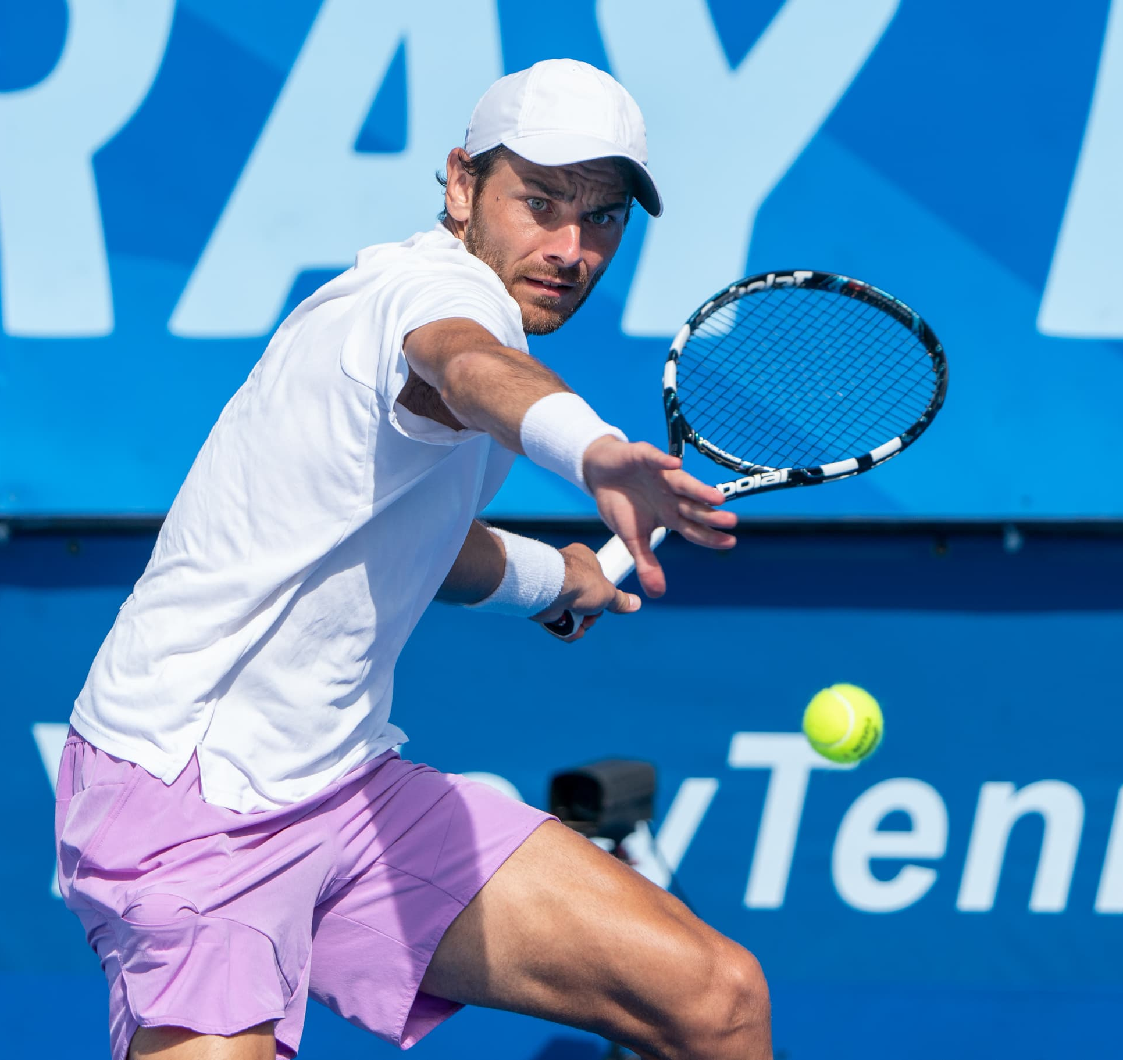
Step 1
The employee must show:
They are a member of a protected group
That they were qualified for their position
That the circumstances of their discharge raised an inference of discrimination

Slide 20
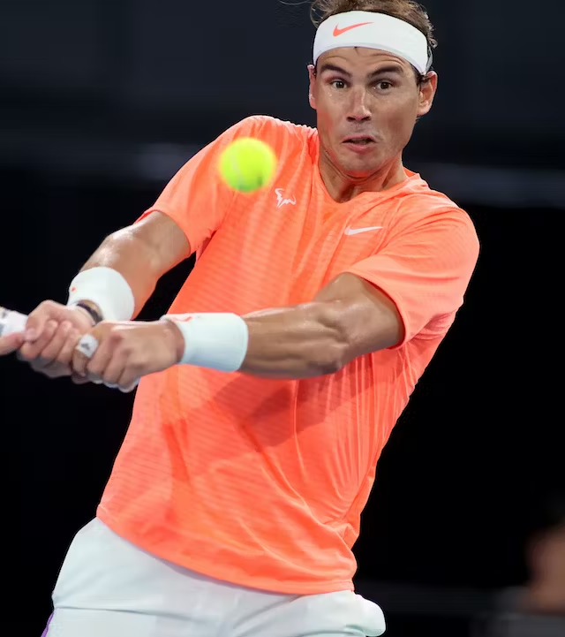
Step 2
What does the employer have to articulate?
That the employee had it coming to them and they were universally disliked
That they went through the proper HR procedure to terminate the employee
Any legitimate, non-discriminatory reason for its actions

Slide 21
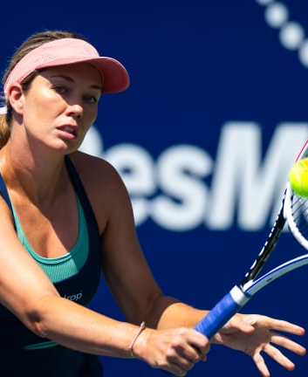
Step 3
Employee must prove:
That the employer’s offered explanation is pretextual or, while true, was not the only reason for their termination; their protected class was another motivating factor

Slide 22

Was Feeback’s unruly conduct considered a pretext for age discrimination?
YES
NO

Slide 23
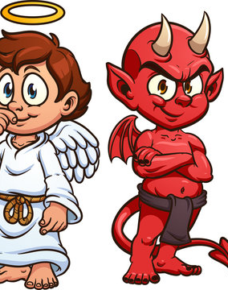
Honest Belief Rule
“Critical inquiry… is not whether the employee actually engaged in the conduct for which he was terminated, but whether the employer in good faith believed that the employee was guilty of the conduct justifying discharge”

Slide 24
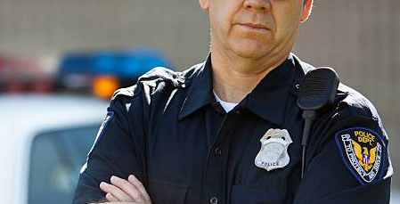
Martin v. Tovar and the City of Muscatine
Traffic stop of a vehicle driven by David Faust
Faust was arrested on the charge of driving while intoxicated and transported to the police station
Shari Martin was a passenger in the vehicle and was also intoxicated
Police departments common practice for officers to give passengers not under arrest a courtesy ride home
Officer Thomas Tovar drove Shari to a nearby hotel where he sexually assaulted her

Slide 25
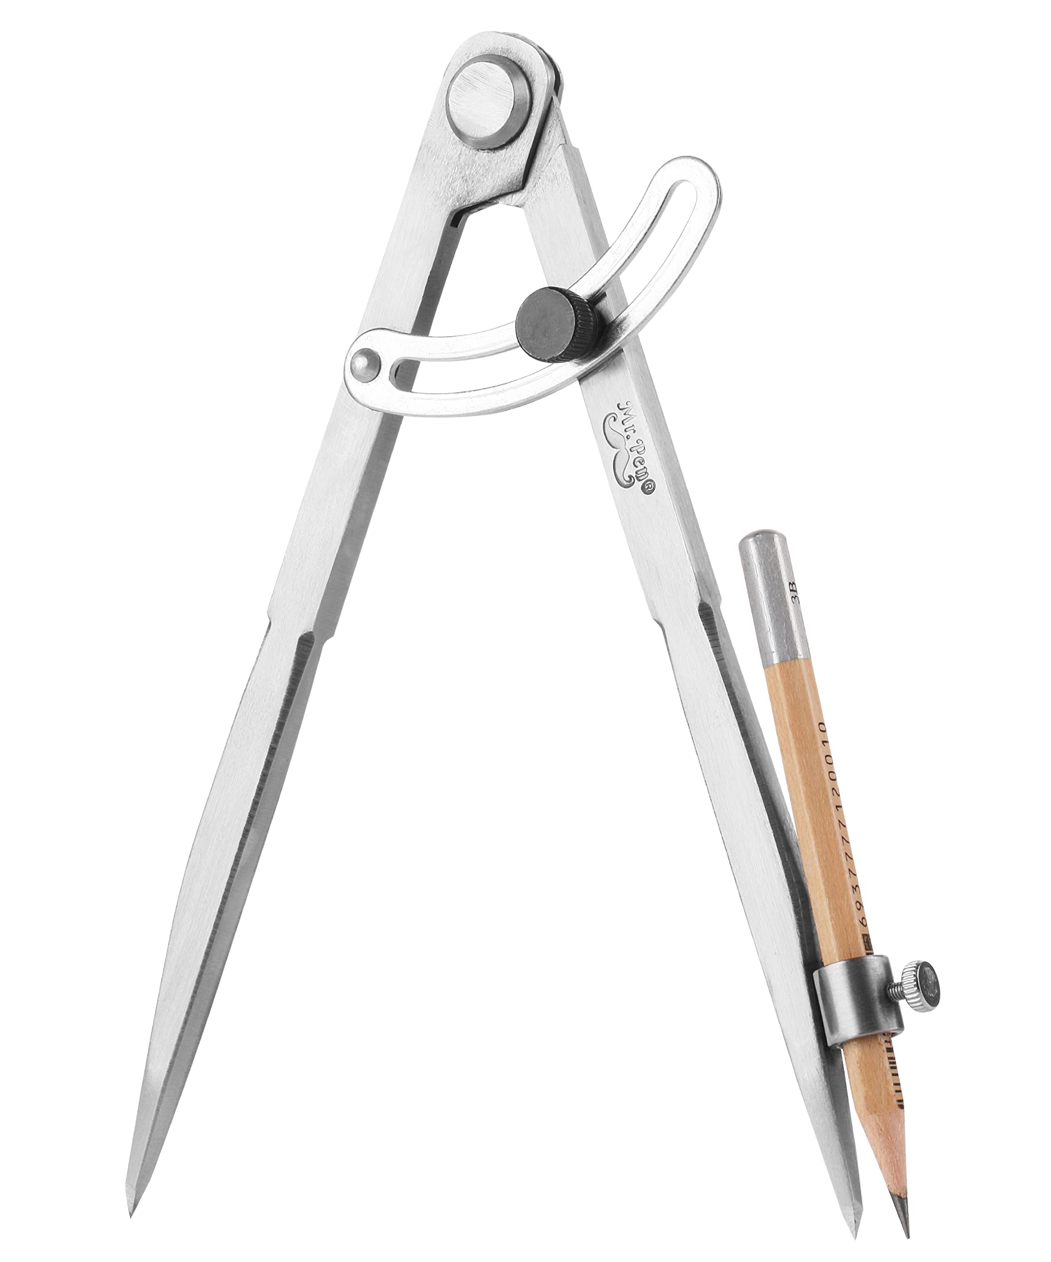
Scope of employment?
Not within the scope of his employment
His act was “so unusual or startling under the circumstances, and such a departure from the officer’s duty”
Furthered no purpose or aim of the city
No foreseeability for his actions
Accusation regarding previous SA only surfaced after lawsuit was filed

Slide 26

Aided by Agency?
Section 219 of the Second Restatement
An employer may be held vicariously liable for an employee’s tortious conduct if the employee “was aided in accomplishing the tort by the existence of the agency relationship”
Previously narrowly used in hostile work environment claims
The court rejected the theory
“It comes close to creating strict liability for employers, and, despite purporting to be an exception, it nearly swallows the general rule that respondeat superior does not attach to intentional torts.”

Slide 27

Husk me anything!

