Slide 1
Iowa Defense Counsel Association Annual Meeting - 2023 APPELLATE PRACTICE TIPS
Iowa Court of Appeals – Chief Judge Thomas Bower, Judge Sharon Soorholtz Greer and Judge Tyler Buller

Slide 2
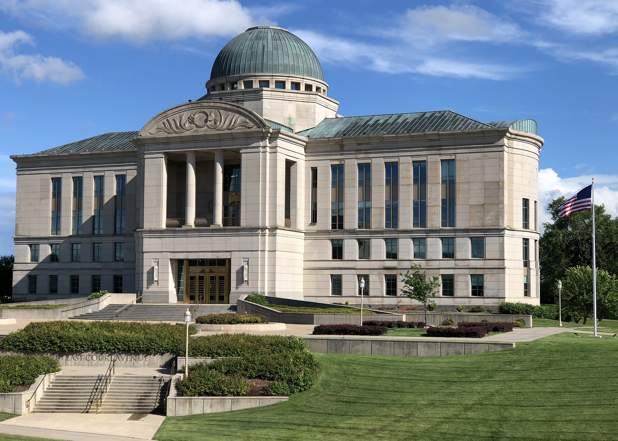

Slide 3
Chapter 6 - Rules of Appellate Procedure Substantive Review Task Force
Justice Dana Oxley, Co-Chair, Iowa Supreme Court, Swisher
Justice David May, Co-Chair, Iowa Supreme Court, Polk City
Judge Paul Ahlers, Iowa Court of Appeals, Fort Dodge
Judge Tyler Buller, Iowa Court of Appeals, Des Moines
Kodi Brotherson, attorney, Sac City
Mathew Zinkula, staff attorney, Iowa Supreme Court, Des Moines
Donna Humpal, Clerk of the Iowa Supreme Court, Des Moines
Ryan Koopmans, attorney, Des Moines
Martha Lucey, State Appellate Defender, Des Moines
Christine Mayberry, Deputy Clerk of the Iowa Supreme Court, Des Moines
Benjamin Parrott, attorney, Urbandale
Nancy Penner, attorney, Cedar Rapids
Alesha Sigmeth Roberts, attorney, Clarion
Mikkie Schiltz, attorney, Davenport
Leon Spies, attorney, Iowa City
Jeffrey Thompson, Iowa Solicitor General, Des Moines
Scott Wadding, attorney, Des Moines

Slide 4
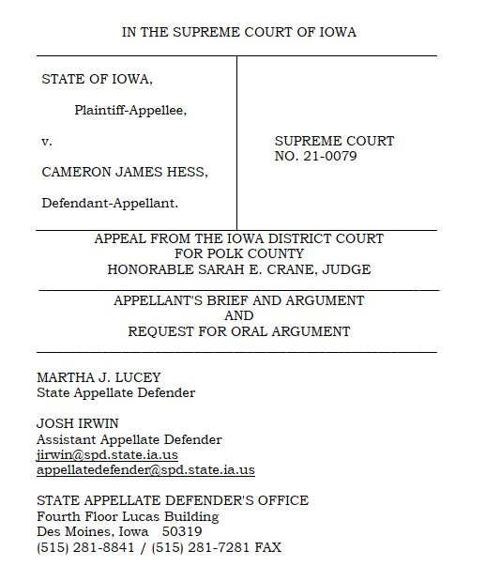
No More Proof Briefs
Proof
Final

Slide 5
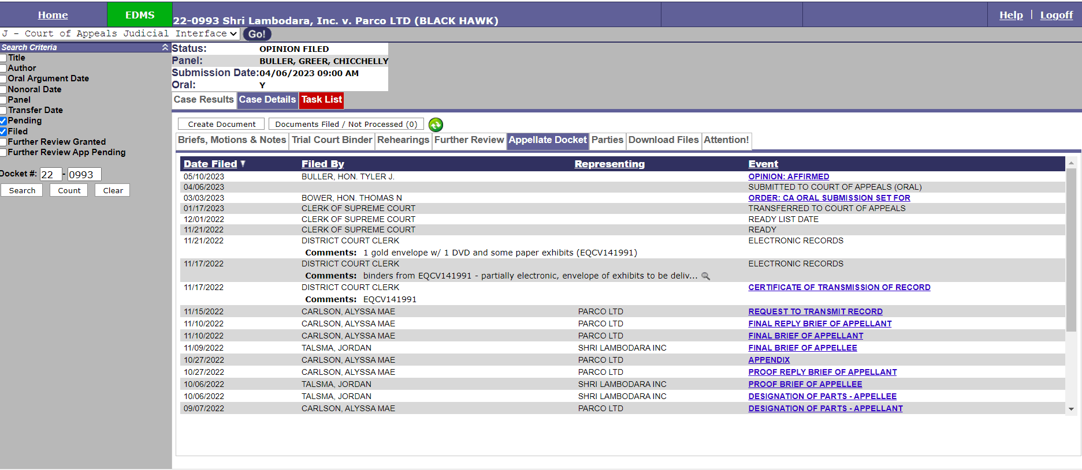
How do we access court files? Appellate Docket

Slide 6
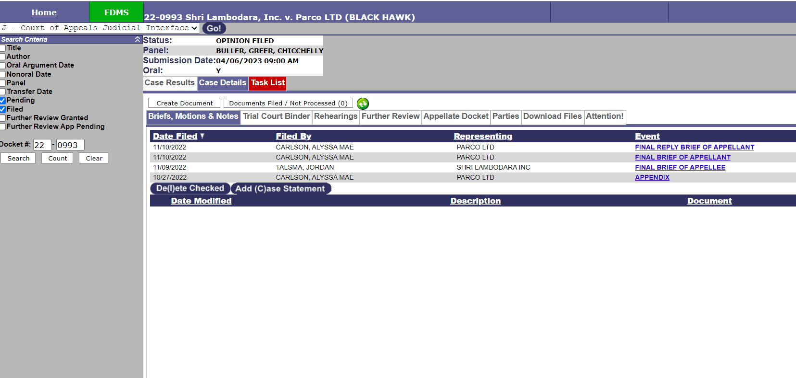
How do we access court files? Briefs, Appendices, and Notices

Slide 7
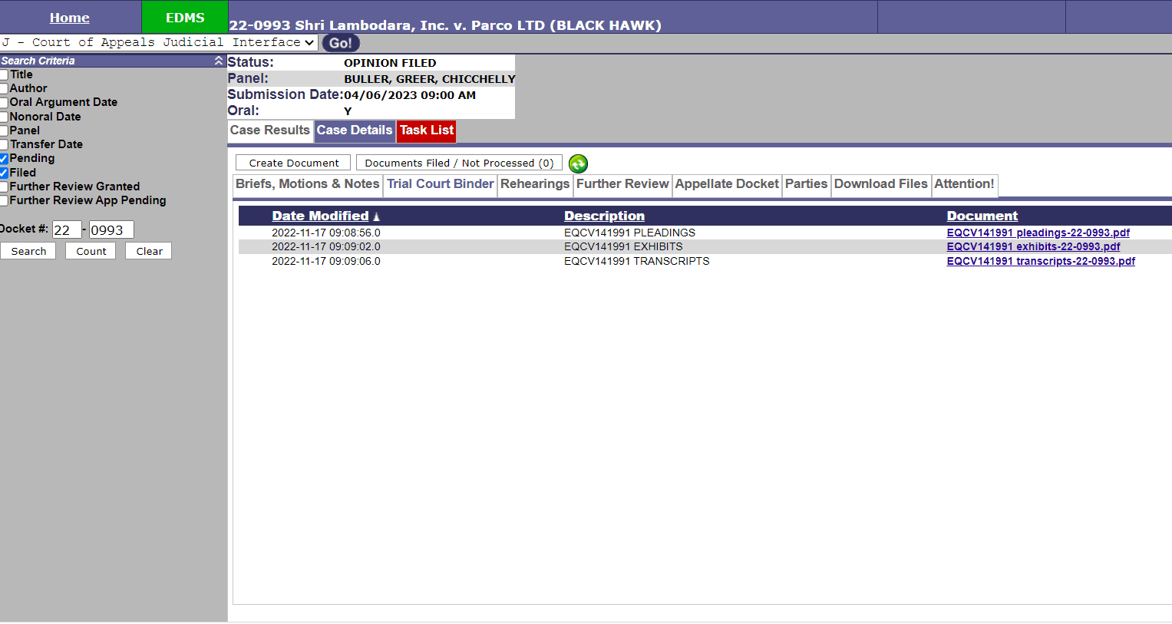
How do we access court files? Trial Court Binder

Slide 8
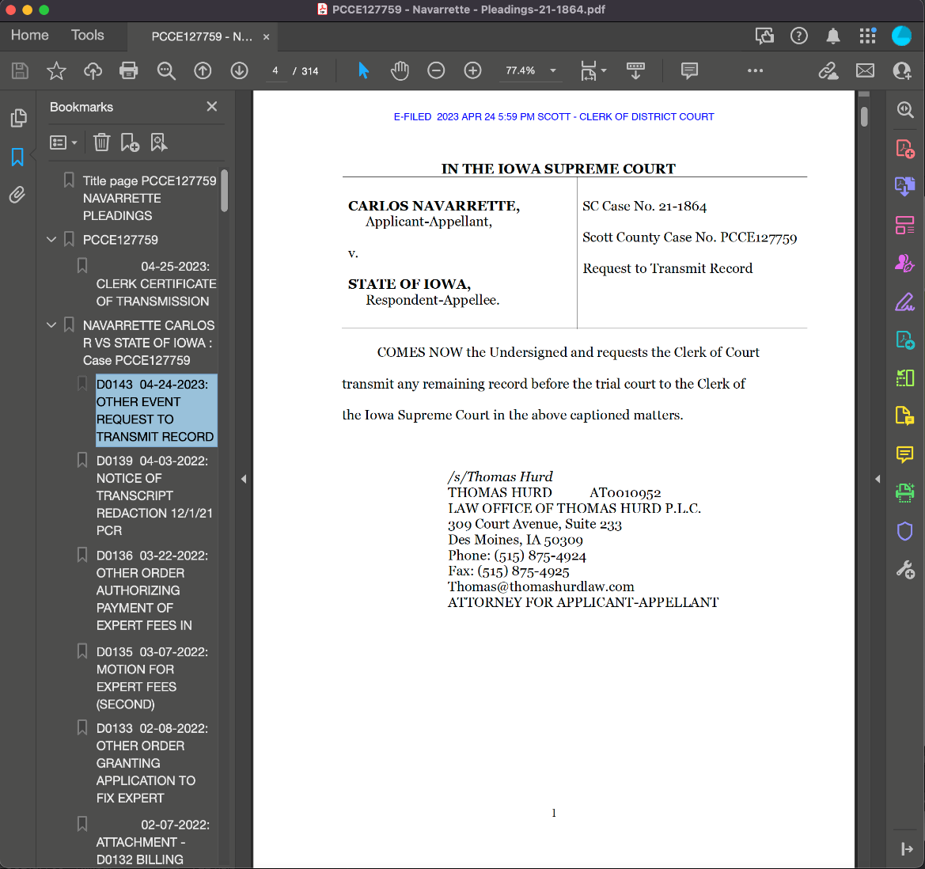
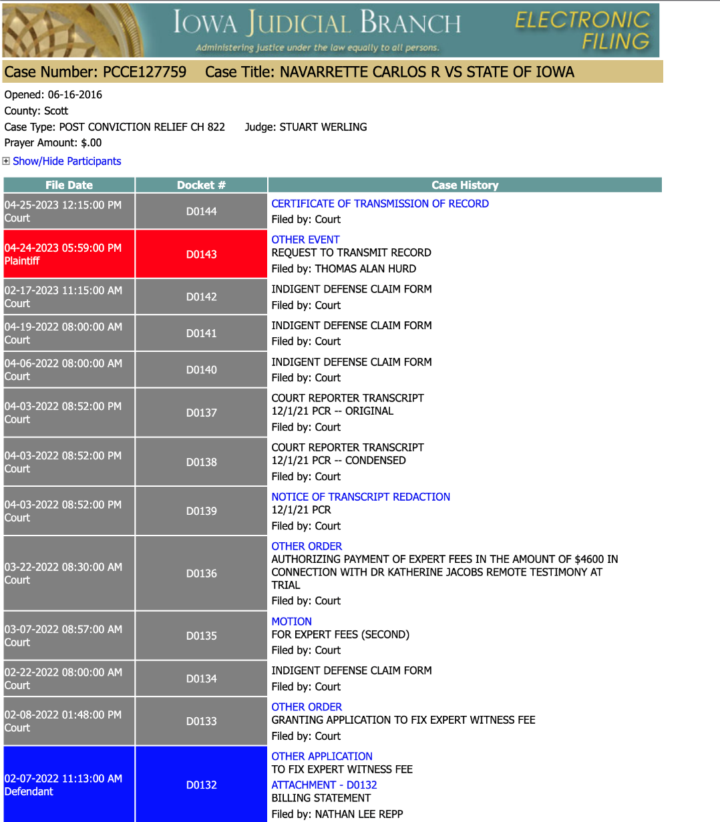
But … docket numbers have arrived

Slide 9
The Iowa Court of Appeals - generally

Slide 10
What is the Court of Appeals?
A statutory court created “to dispose justly of a high volume of cases.” Iowa Ct. R. 21.11.
Average of 1,178 opinions filed per year over the last decade.
Slight dip during COVID, but headed to back to that 1100-ish number.

Slide 11
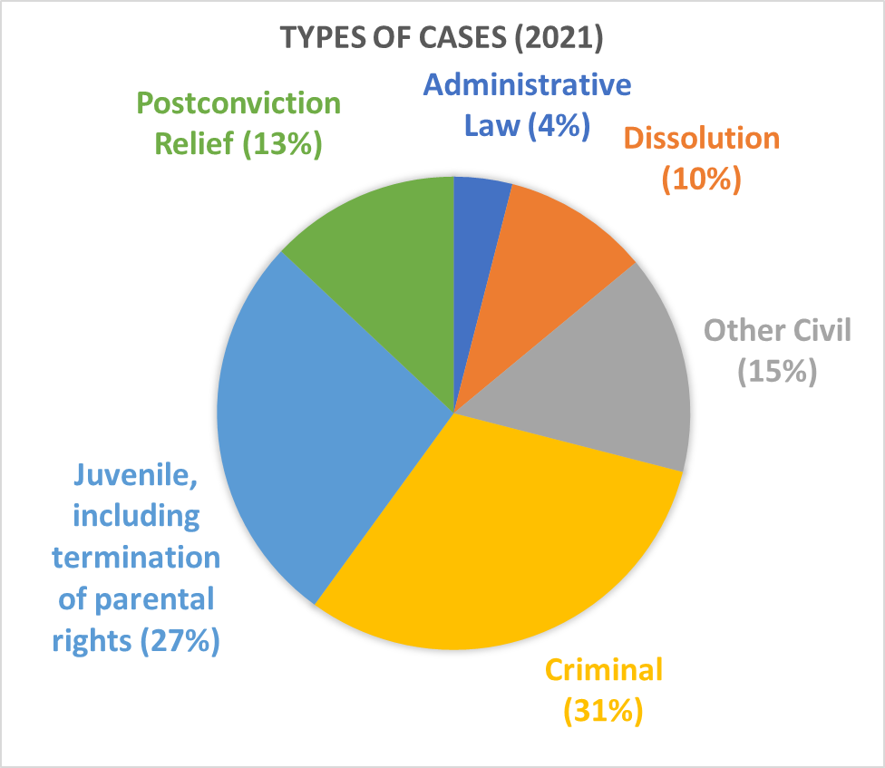
What kind of cases?
We all have to be generalists.

Slide 12
The Internal Workings.
Three-judge panels rotate every quarter
The court sits en banc in <1% of cases
Opinion authors are randomly assigned (assuming you keep a majority)
Most cases—about 90%—are decided without oral argument.

Slide 13
The Workload:
Approx. 1,100 cases:
Active judges (per year):
100ish cases to author
200ish panel cases
Senior judges (per year)
25ish cases to author
50ish panel cases

Slide 14
Expected Outcomes from the District Court or Jury Decisions - Given the Statistics:

Slide 15
Rehearing Petitions and Further Review
The Court of Appeals grants <10 % (and often <5%) of rehearing petitions per year.
Tip: Do not re-hash your brief; zone in on how the COA got it wrong, i.e. you forgot about this case.
There are between 450-500 applications for further review but only about 10% are granted and the COA decision is vacated in just over one-half of the time.

Slide 16
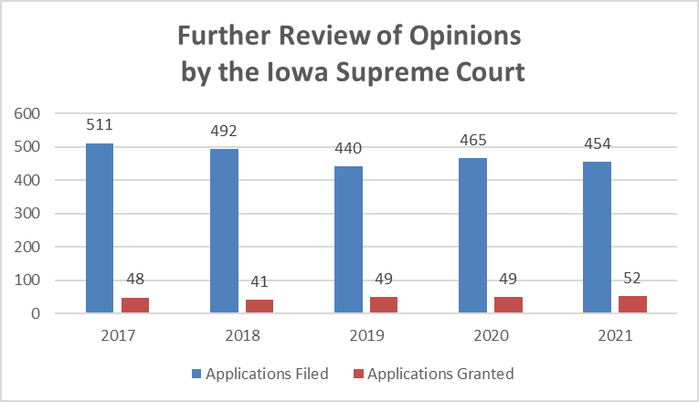
Supreme Court Statistics on Further Review.

Slide 17
Now to the Meat – Practice Pointers

Slide 18
Brief Writing Tips

Slide 19
Be forward and succinct—get straight to the point.
A concise introductory paragraph helps the court.
What is the case about? What did the prior court decide? How is your approach the correct one and what relief do you seek?
You only have one chance to make a first impression—your brief is your first impression to the appellate court.
The courts know the pressures and economic constraints of today’s law practice, but a hurried, error-filled, sloppy cut-and-paste job does not impress. Have the brief proofread by someone other than you.

Slide 20
Tell a story
Lay the facts out logically in a narrative, but don’t feel you just have to lay out a chronological history if the story is better told otherwise.
Avoid repetition of the same arguments over and over—edit the chaff.
Accurate citations to the record are important.
Each fact should have a citation to the record or appendix.

Slide 21
Cite legal authority for each legal premise or it may be deemed waived.
“Failure to cite authority in support of an issue may be deemed waiver of that issue.” Iowa R. App. P. 6.903(2)(g)(3).
Be succinct, but a glancing mention without authority or analysis is not enough to raise an issue for review.
See EnviroGas, L.B. v. Cedar Rapids/Linn Cnty. Solid Waste Agency, 641 N.W.2d 776, 785 (Iowa 2002).
Analyze state and federal constitutional challenges separately.
See Doss v. State, 961 N.W.2d 701, 736 (Iowa 2021) (McDonald, J., concurring)

Slide 22
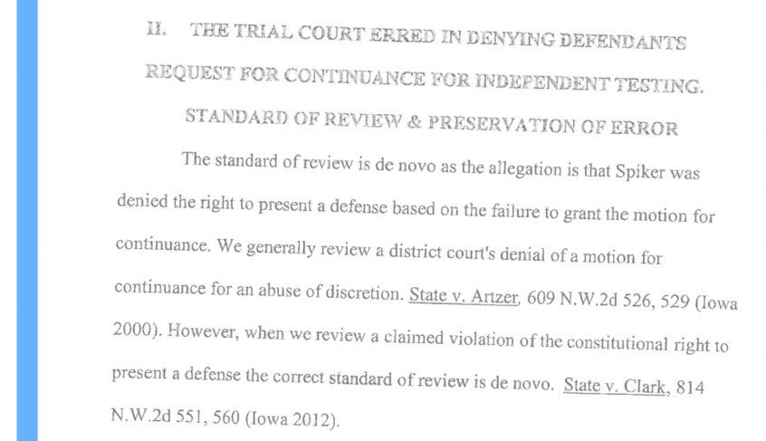
Electronically signing your documents and saving them as a pdf rather than printing, manually signing them, and then scanning them has two huge benefits. (1) word searchable and (2) improves legibility of the text. Also remember that your brief is public document.

Slide 23
Tell the court how and where each issue was raised and preserved in the record.
Error is preserved when an issue has been both raised and ruled upon by the district court, not simply by filing a notice of appeal.
Meier v. Senecaut, 641 N.W.2d 532, 537 (Iowa 2002)
Do not cite to items not in the district court record even if you have placed them in your appendix. (Those items should not be in your appendix)
See Iowa R. App. P. 6.801 (defining the record); In re Marriage of Keith, 513 N.W.2d 769, 771 (Iowa Ct. App. 1994) (disregarding matters outside the appellate record)

Slide 24
Instead of “appellant” and “appellee,” use the parties’ names, such as “Todd” or “Katherine,” or a descriptive term, such as “the husband,” “the paramour,” or “the law clerk.”
Iowa R. App. P. 6.904(1)
Give the page number where the quotation from a case will be found (i.e. use pincites).
We find maps, charts, and diagrams particularly helpful. Be aware the current rules do not expressly address images in briefs, but the task force has recommended adopting clear guidelines. A picture can be worth a thousand words—and may save you from having to write that many.

Slide 25
Consider what information you put in footnotes and limit the use of them.
Use footnotes to supplement the story, but not for facts or law critical to your theme, so use them for truly extraneous material.
Do NOT put the authority for the legal point made in your brief in a footnote.

Slide 26
But, in cases declared confidential by any statute or rule of the supreme court, refer to the parties in both the caption and text by first name or initials only. When the victim’s name is deemed confidential by law, the brief must refer to the victim by first name or initials only.
Iowa R. App. P. 6.110(5)(b)
Confidential or unredacted documents must be in a SEPARATE appendix that contains only confidential documents – don’t forget to certify the appendix.
Iowa Rs. App. P. 6.905(14), 6.110(2)

Slide 27
Be careful about confidential information you may be exposing in your brief, such as mental health information, unless it is critical to the case.
Try not to absorb your client’s trauma … or project it in your briefs or arguments.
Don’t lob personal attacks at opposing counsel. It only hurts your credibility.
Please don’t file depositions or exhibits with condensed-page transcripts. It’s against the rules, and it’s killing our eyes.

Slide 28
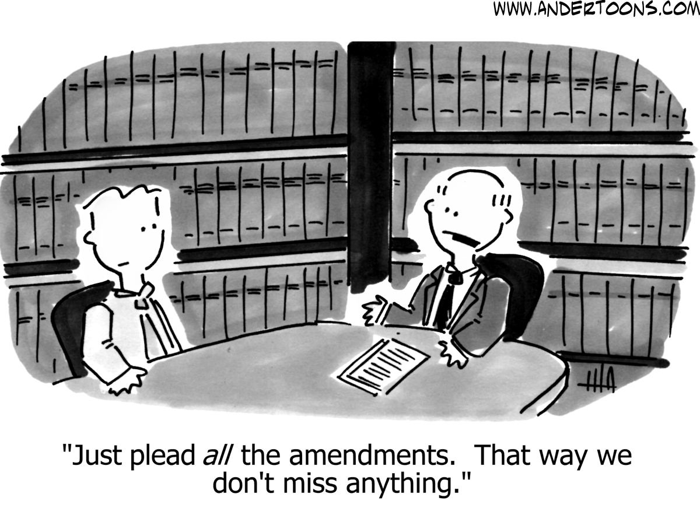
Trim your issues. There has never been a case with 14 separate viable appellate claims.

Slide 29
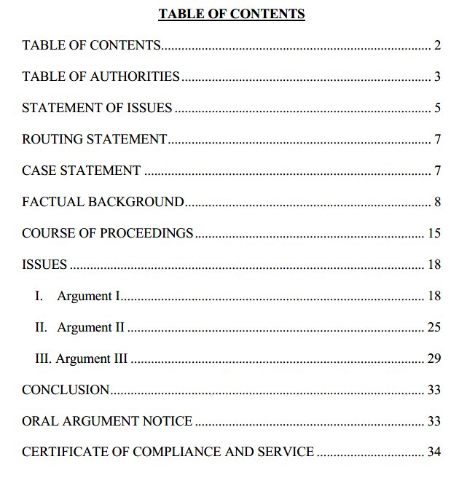
Use Headings in the Table of Contents to Clearly Define Your Issues:
vs.

Slide 30
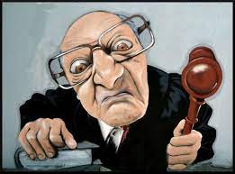
Tips for your Oral Argument

Slide 31
It’s your chance to clear up any misunderstandings and answer our questions.
Despite myths to the contrary, oral arguments can—and do—change a judge’s mind.
Don’t waste your precious time reciting all of the facts.
Don’t bring up facts outside the record, including what has happened since the trial, or misrepresent facts.
Be professional in your speech and dress.

Slide 32
Point the panel to your most important and strongest arguments. Zone in at the start with why the decision below was correct or wrong and what the answer should be under your facts.
Answer questions directly and with the law or facts that support your position.
Know what the case’s weaknesses are and do not hide from them in argument. Find a way to make them helpful to your proposed solution.

Slide 33
If you are splitting time with co-counsel or another party, it is up to you to manage your time—the timer will not stop as you switch out.
If at all possible, don’t split time—pick one attorney to argue all issues
Oral argument is a conversation with the court. Anticipate questions and answer them directly, even if that means saying “I don’t know.”
Avoid becoming overly emotional or raising your voice to the court.

Slide 34
Answer the judge’s question—there is a reason for it. You should think about welcoming the questions because they give you the chance to address a concern that might help your client.
Respect the red light. When the red light comes on the timer, ask for time to conclude your thought and, if given permission, do so promptly.

Slide 35
Remote Arguments
Treat your virtual oral argument with the professionalism you use when you are in-person. Normal courtroom decorum rules, including dress code, apply.
Watch for visual cues when judges wish to ask a question so you do not speak over them.
Mute the microphone when not arguing. Note that tapping your pen or other distracting habits are more pronounced during virtual arguments.
Make sure you have a good microphone or audio system and that noises, such as your family pet, are not going to be present.
Practice in the mirror to get a feel for how your presentation will look. Take care where you place your camera angle.
Be sure and note the clock on the screen and ask permission if your time expires.

Slide 36
Other tips our staff will offer you during the training session before arguments:
Avoid bright lights or windows in the background.
If using the conference call feature for audio, please keep the conference call phone as close as possible.
Ask others using your Wi-Fi network to minimize their usage during your argument so you have the best possible connection.
Speak slowly and try to avoid talking over others.
Moot your argument remotely in advance of the scheduled argument.

Slide 37
Try to avoid flipping through notes, clicking your pen, etc. near your computer microphone or phone to keep the background noise at a minimum. Turn off all audio alerts or close programs that may disrupt your argument.
Desktop or laptop computers often provide better video and audio quality than tablets or mobile phones. The use of a headset can also enhance the audio quality.
It is acceptable to stand or sit during your oral argument so long as your positioning does not negatively affect the quality of your oral presentation and your camera is positioned so that your face is visible.
Look directly at the webcam, not the screen.

Slide 38
TIME FOR QUESTIONS

