Slide 1
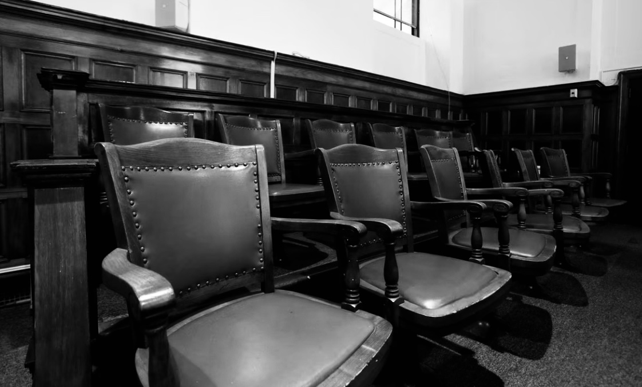
IOWA CIVIL VERDICT TRENDS & EFFECTS ON SETTLEMENT
JEFF BOEHLERT
BOEHLERT BROWNLEE ADR
AMANDA M. RICHARDS
BETTY, NEUMAN & McMAHON, P.L.C.

Slide 2
THE RE-LAUNCH OF THE JURY VERDICT REPORTER

Slide 3
THE IOWA CIVIL JURY VERDICT REPORTER
Maintained by the Iowa State Bar Association.
Tracks Iowa Jury Verdicts throughout the state.
Clerks report to ISBA; ISBA posts data.

Slide 4
CURRENT VERDICT TASK FORCE
Harry Shipley – Iowa State Bar Association
Attorney members:
Brandon Bohlman
Brad Brady
Siobhan Briley
Ann Gronlund
Amanda Richards
Cara Roberts

Slide 5
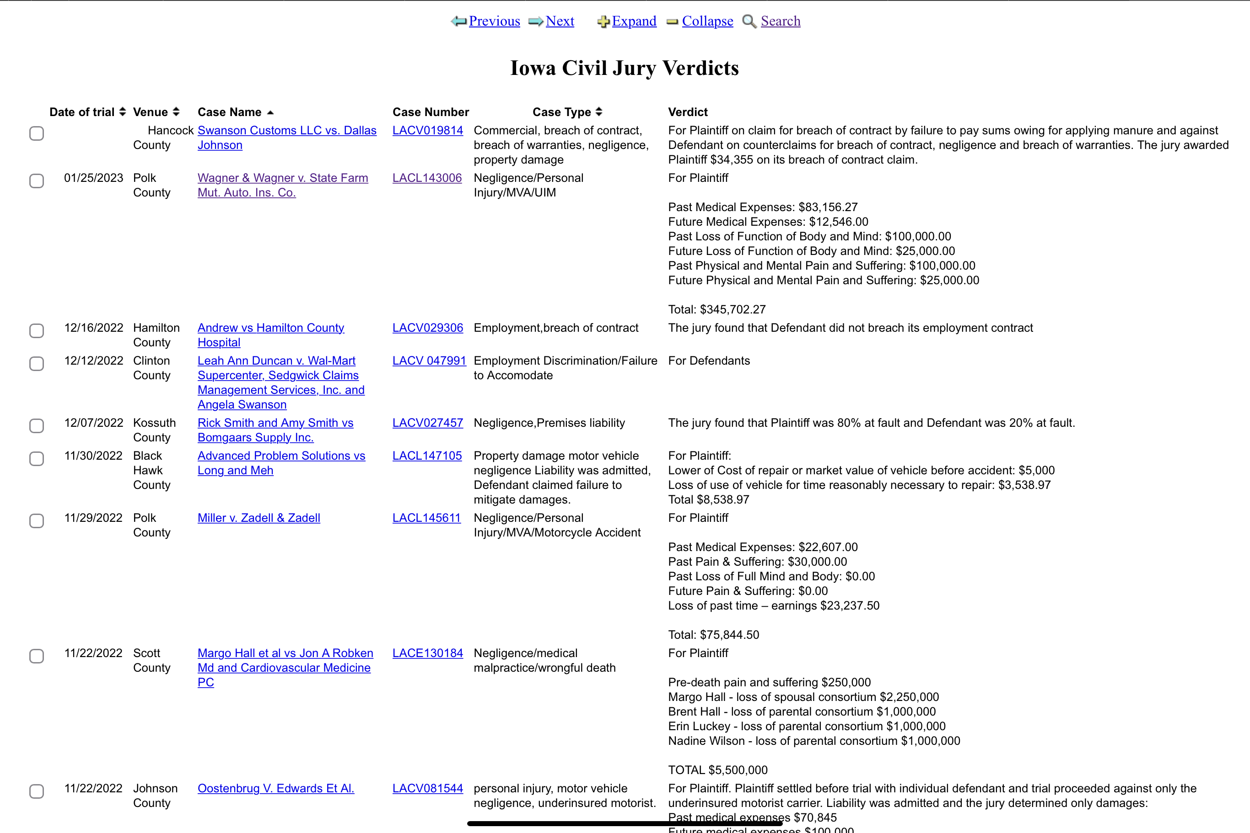
DATE OF TRIAL
VENUE
CASE NUMBER
CASE TYPE
VERDICT

Slide 6
FULLY SEARCHABLE:
CASE NAME, CASE TYPE, COUNTY, TERM

Slide 7
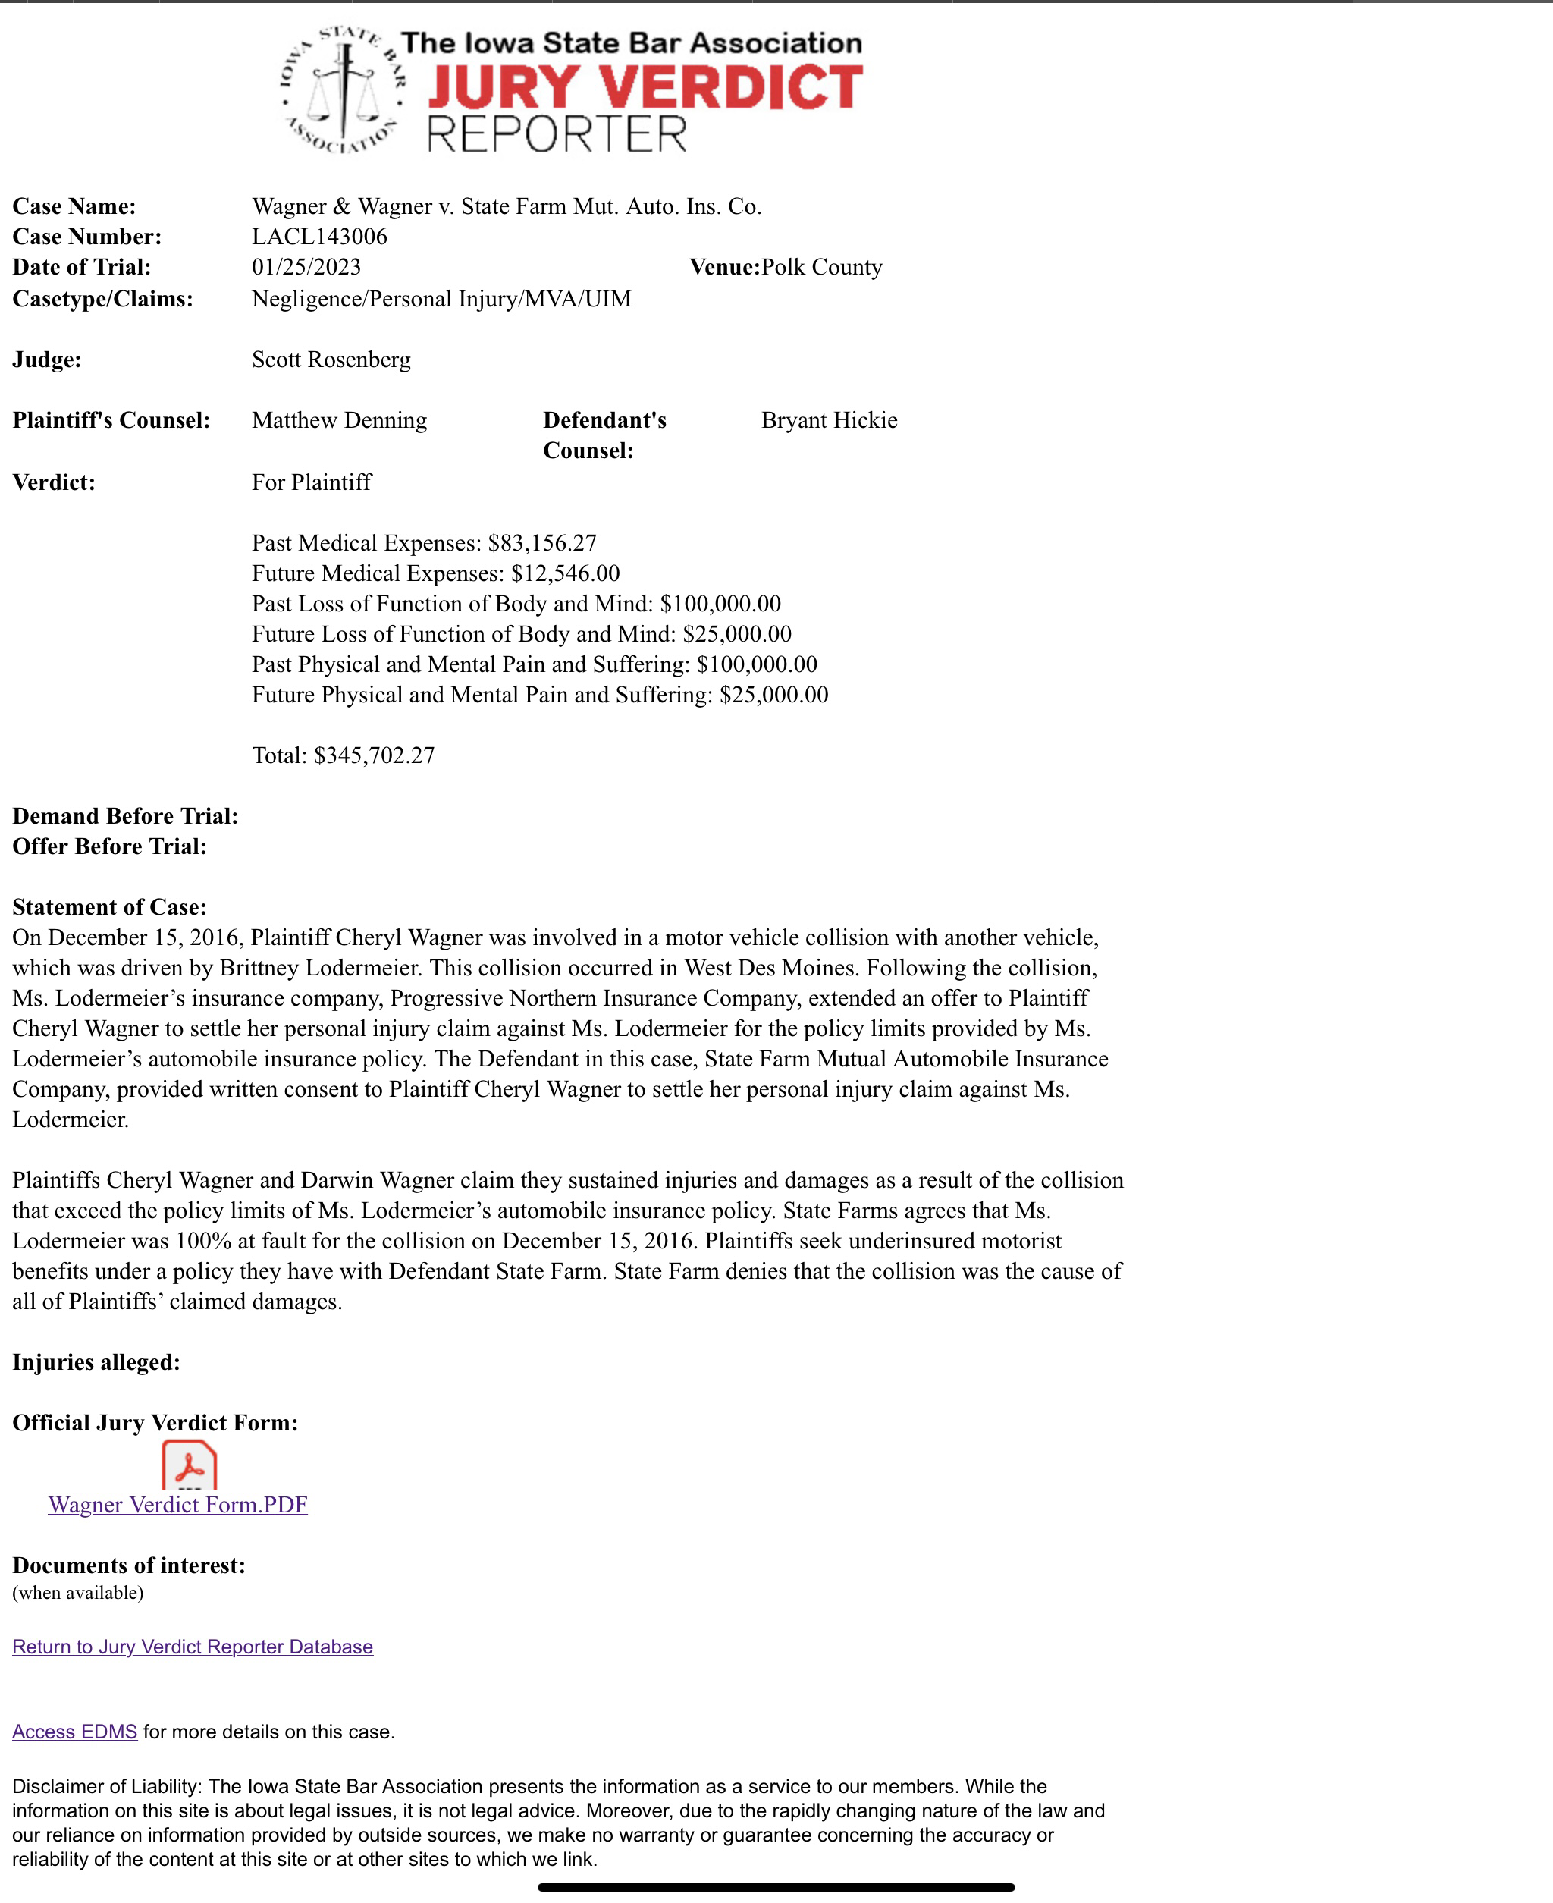

Slide 8
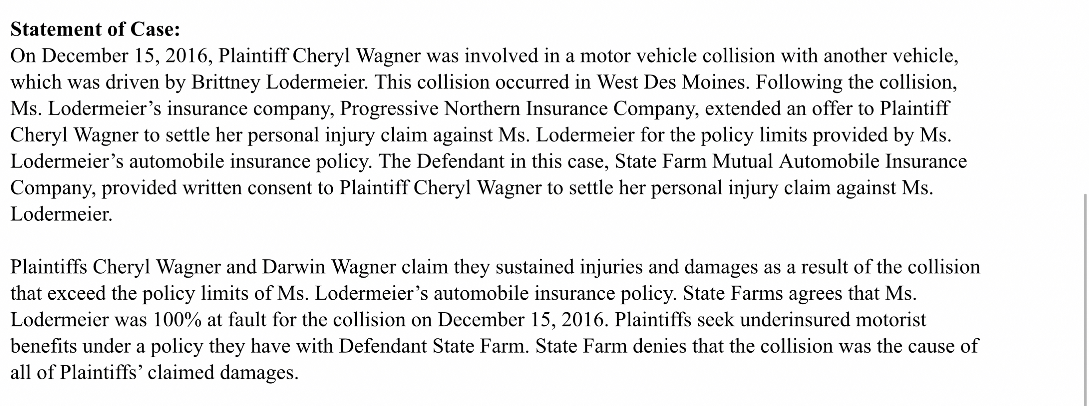

Slide 9
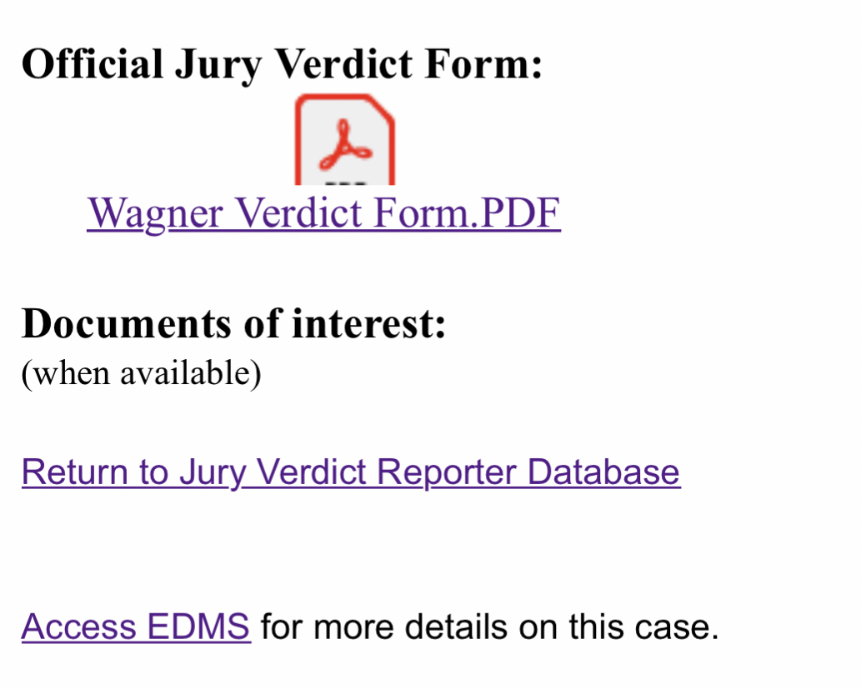
LINKS DIRECTLY TO DOCUMENTS AND EDMS

Slide 10
2020-2022 VERDICT TRENDS

Slide 11
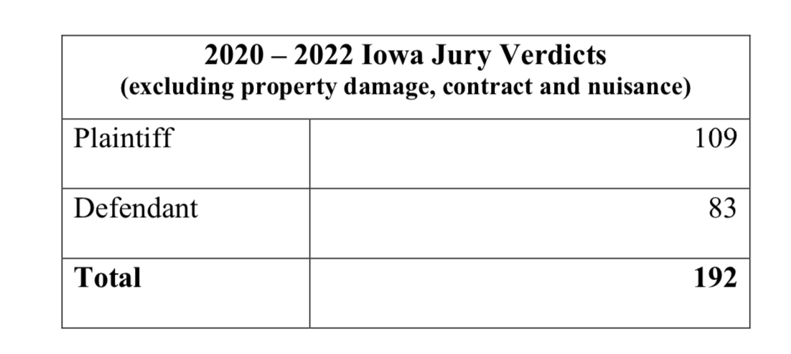

Slide 12
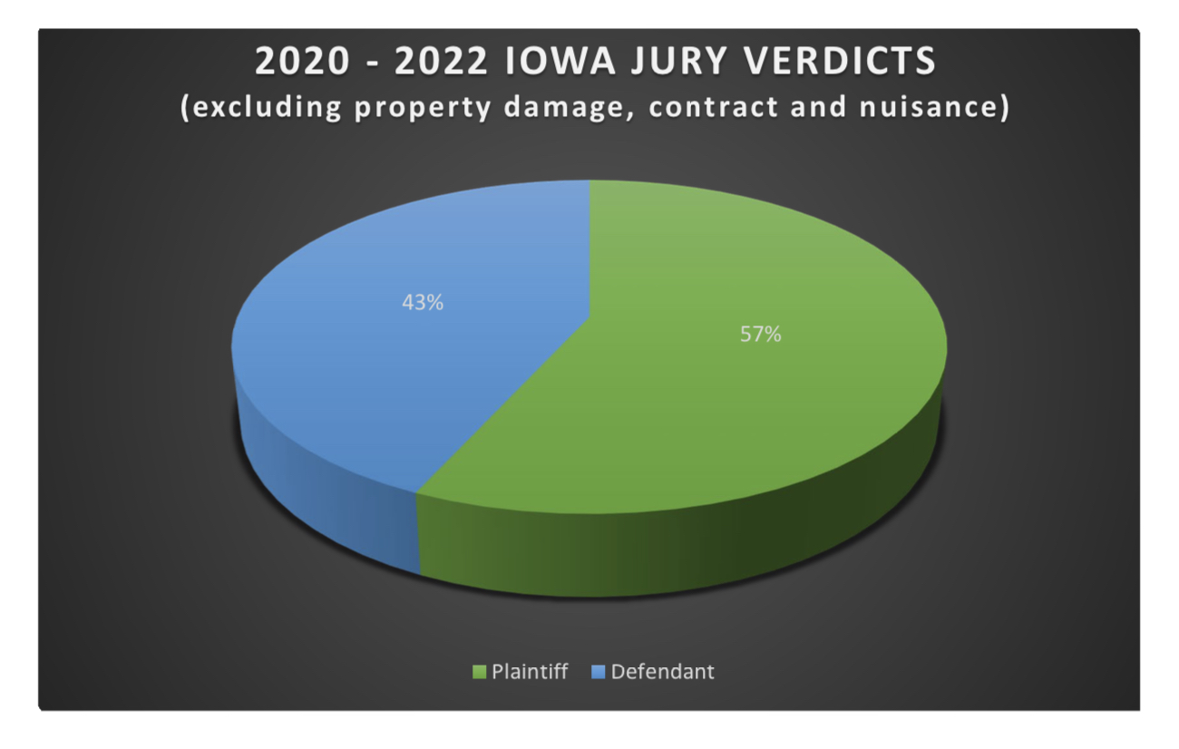

Slide 13
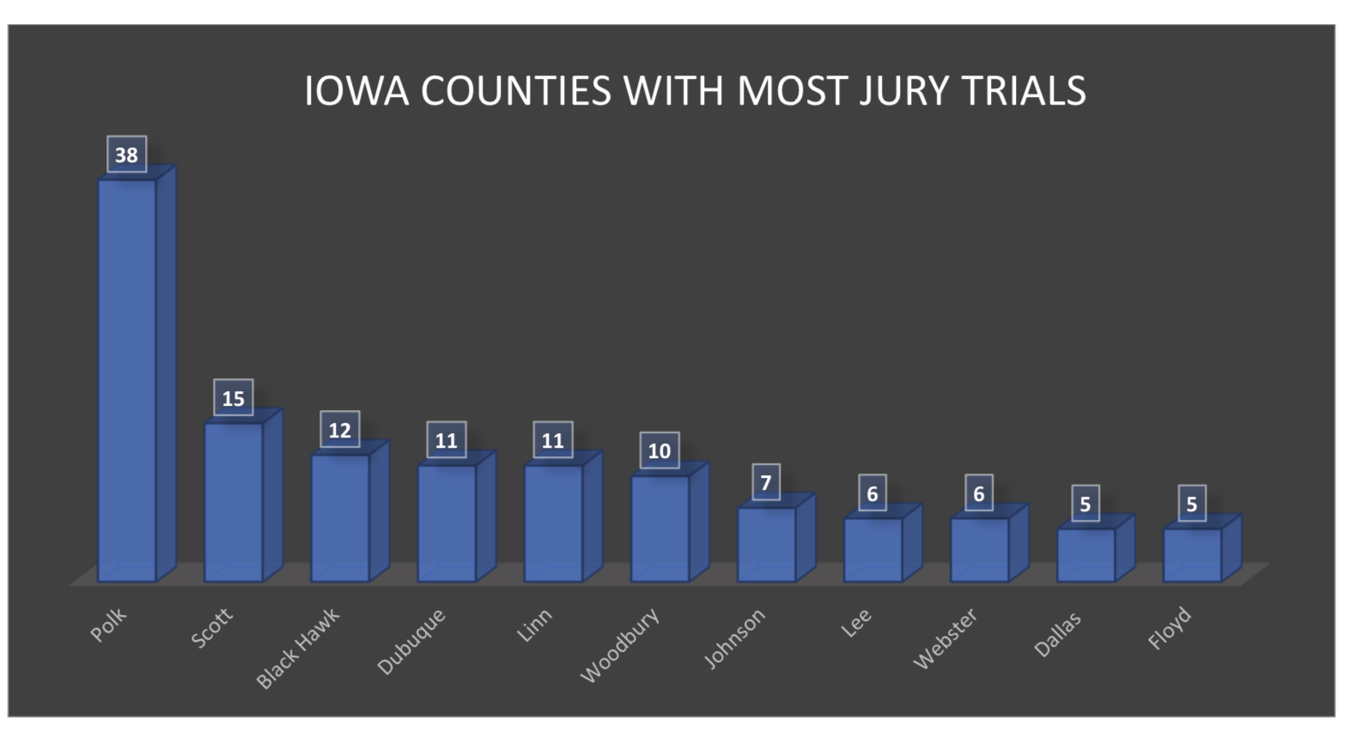

Slide 14
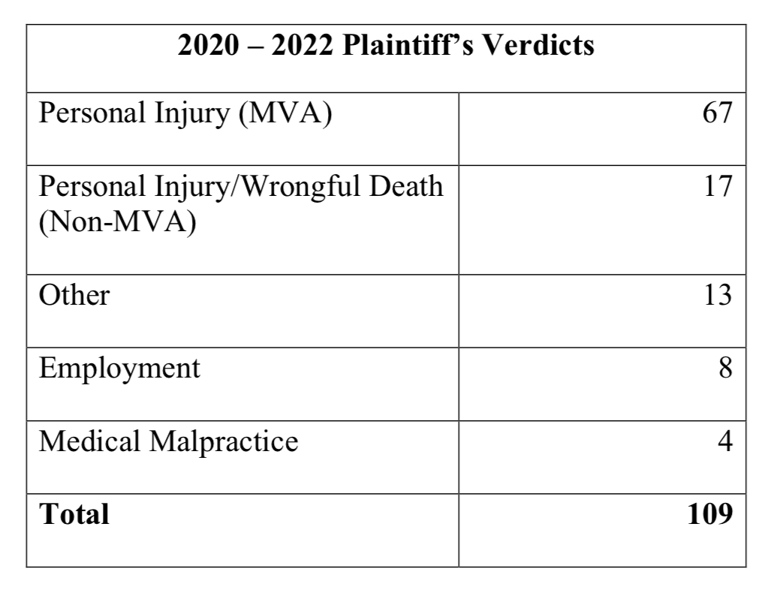
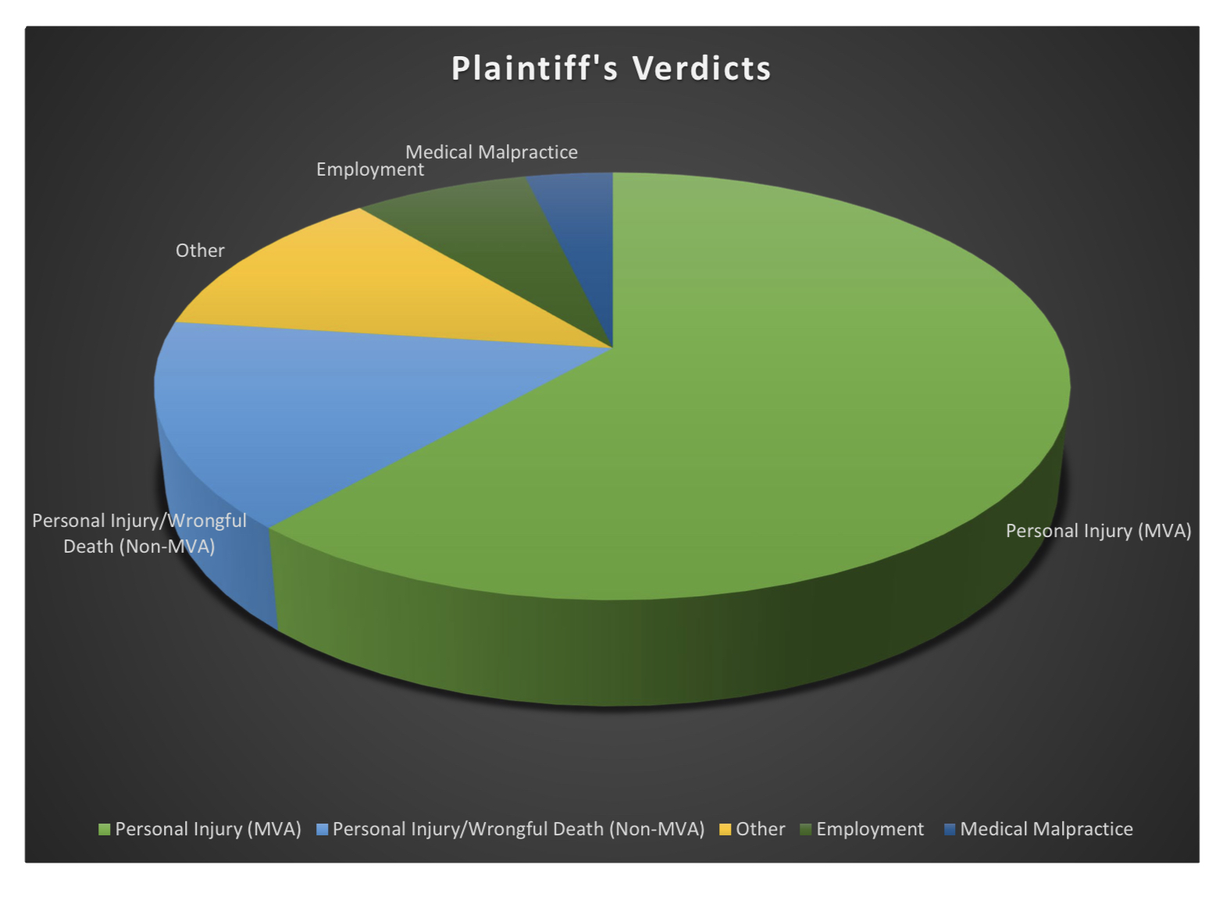

Slide 15
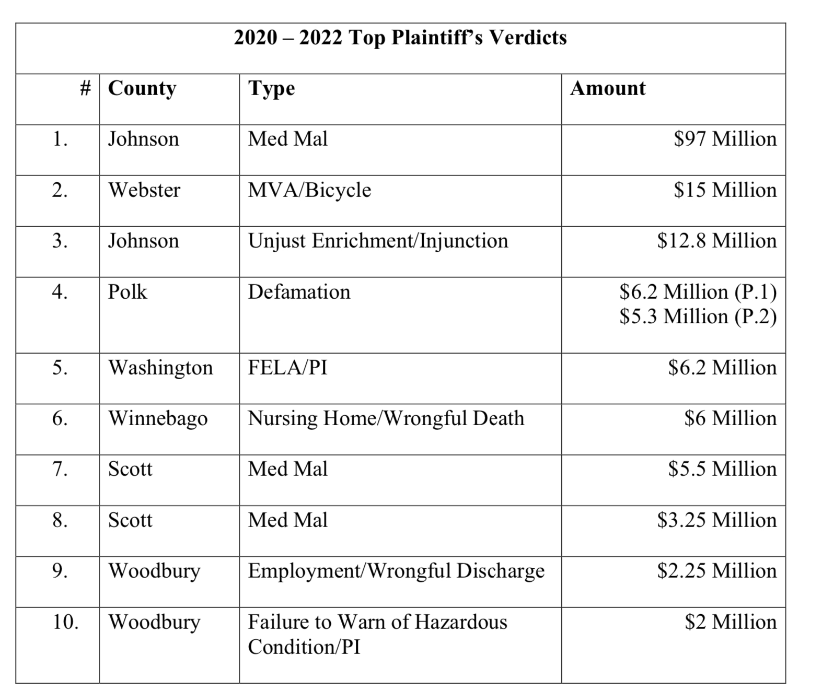

Slide 16
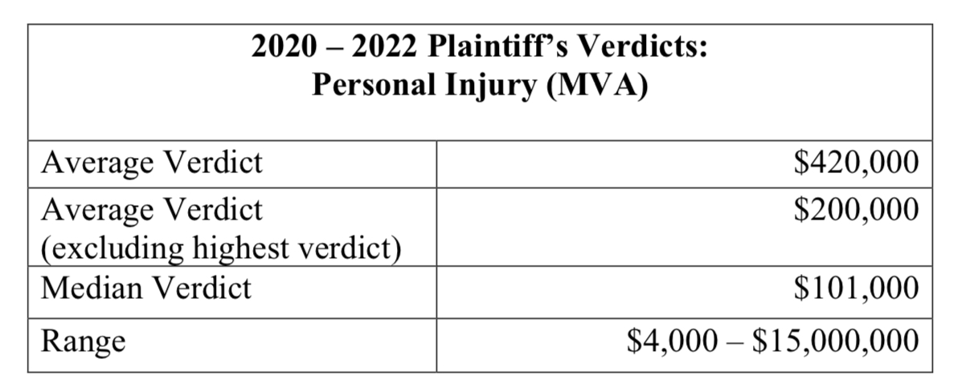
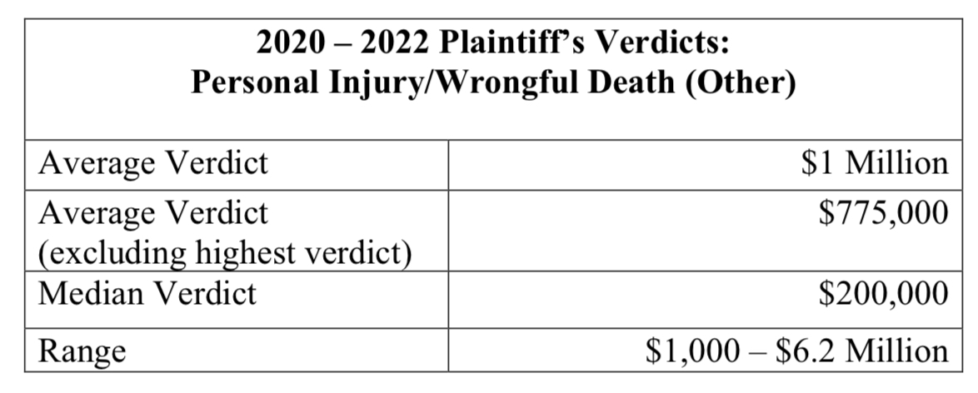

Slide 17
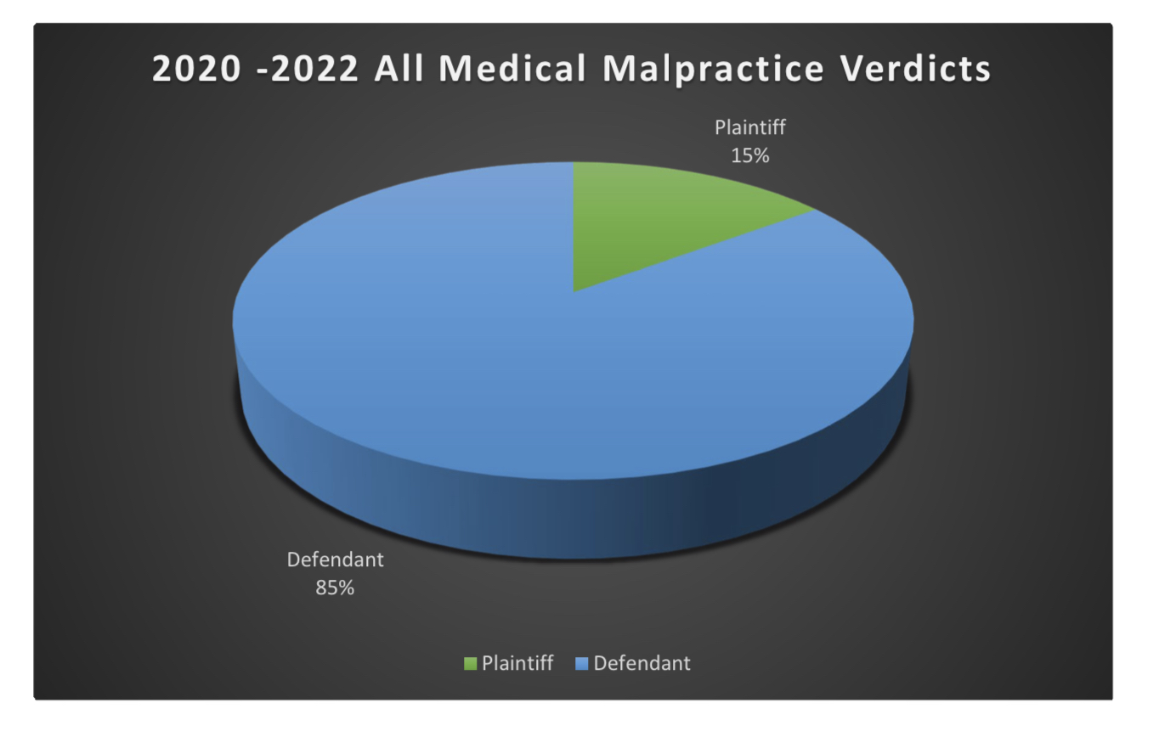
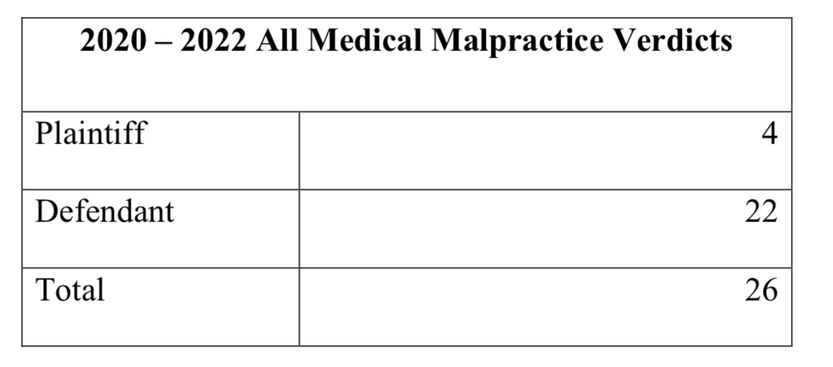

Slide 18
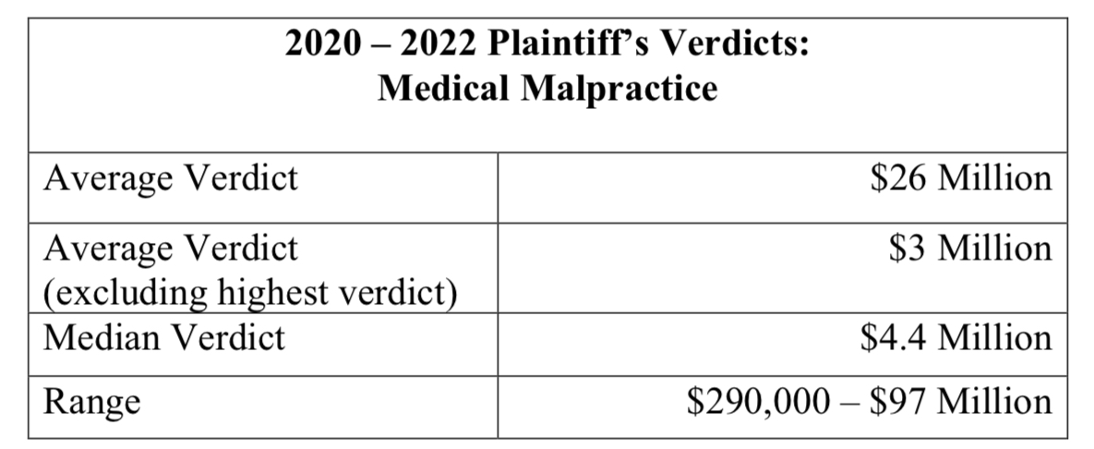

Slide 19
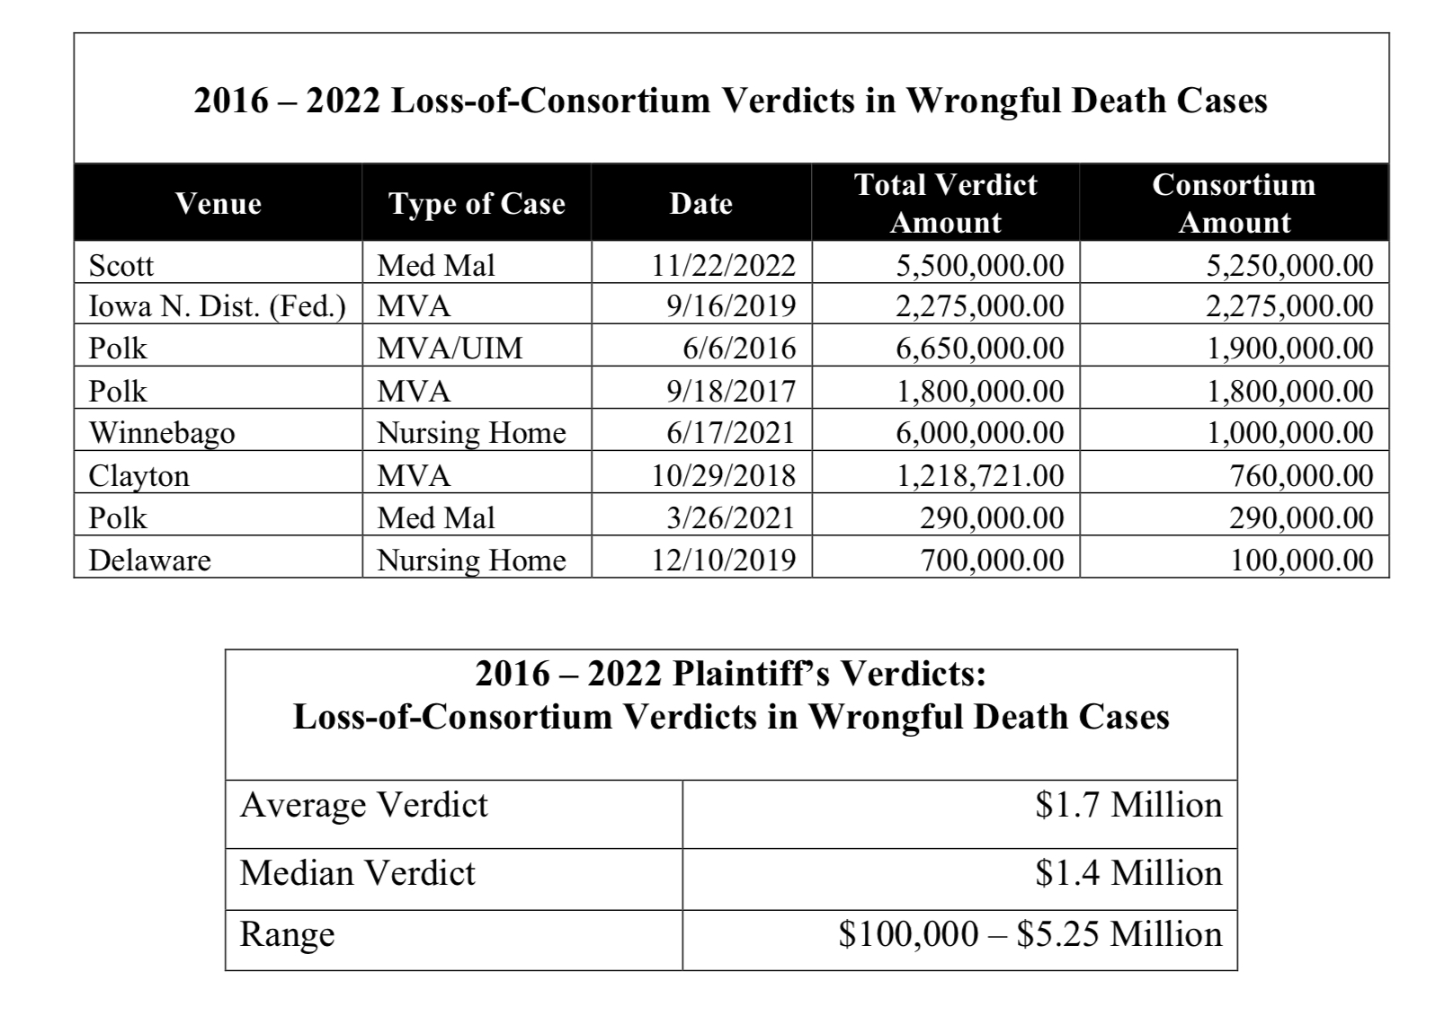

Slide 20
2023 JURY VERDICTS
Current to July 31, 2023

Slide 21
SO FAR….

Slide 22
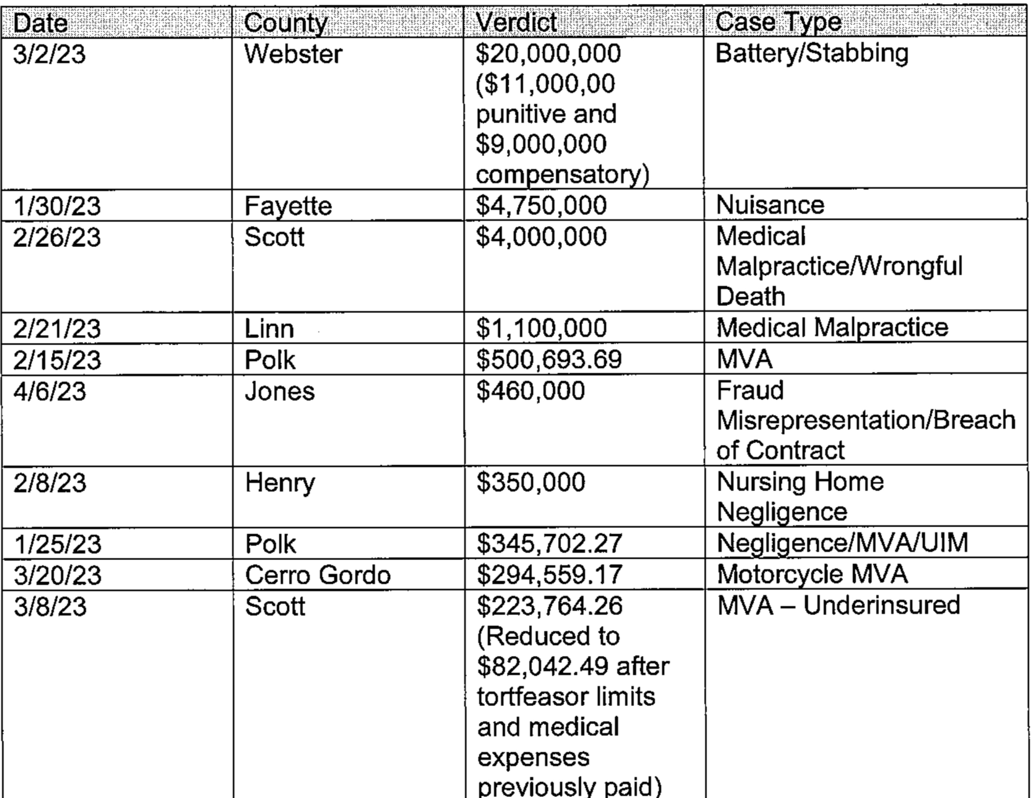

Slide 23
EFFECTS ON SETTLEMENT

