Slide 1
How We Care for Ourselves
Realistic Wellness and Self Care for Defense Counsel
Notes:
Introduce myself

Slide 2
Centering Activity: Alternate Nostril Breathing
Notes:
1 minute
Lowers heartbeat
Lowers BP
Improves breathing
Reduces fear and anxiety symptoms
Sit in a comfortable position
Exhale completely and then use right thumb to close right nostril
Inhale through left nostril and then close left nostril with your fingers
Open right nostril and exhale through this side
Inhale through right nostril and then close this nostril
Open left nostril and exhale through left side
40 breaths

Slide 3
Agenda
Brief Overview of Trauma Informed Lawyering
Overview of Secondary or Vicarious Trauma
Understanding the Stress Response Cycle
Eliminating Stressors and Stress
Modern Law Firm Structure and Culture
Implementing Lasting Changes
Notes:
1 min

Slide 4
Trauma Informed Lawyering
Trauma informed practice is when the attorney puts the realities of the client’s trauma experiences at the forefront in engaging with the client and adjusts the practice approach informed by the individual client’s trauma experience.
Notes:
2 minutes

Slide 5
Developing a Trauma-Informed Practice
If you are developing a trauma informed practice, you will:
Recognize what trauma looks like in a client (memory, anger, denial, depression/anxiety, avoidance, illness)
Be client centered – understanding client’s perspectives, emotions, values.
Maintain respect for client’s decision-making authority
Adjust interviewing and relationship building to meet clients needs
Avoid retraumatizing the client
Identify resources that help clients heal
Notes:
5
Table

Slide 6
Rewards and Risks of Trauma Informed Lawyering
Notes:
Rewards: Get clients what they need. Long term impact on their lives.
Risks: Personal toll, challenges in fitting it into practice

Slide 7
Secondary or Vicarious Trauma
Attorneys “who repeatedly and empathically engage with traumatized individuals can be at risk for distress and impairment due to indirect exposure to another's’ traumatic material.” (Evces)
Harmful changes that occur in professional’ views of themselves, others, and the world, as a result of exposure to the graphic or traumatic experience of their clients.
Notes:
Mark R Evces, What is Vicarious Trauma?, in Vicarious Trauma and Disaster Mental Health: Understanding Risks and Promoting Resilience, 9, 10 (Gertie, Quintangon & Mark R. Evces, eds.) (2015)
How is it different than burnout? Toll work may take over time.

Slide 8
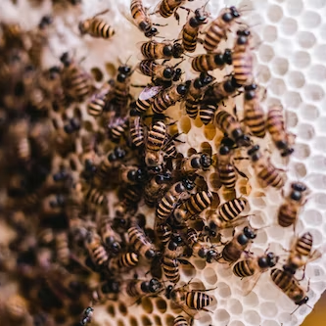
Hives
Notes:
Not these kind of hives.

Slide 9
Symptoms of Secondary or Vicarious Trauma
Feeling Hopeless
Hypervigilance
Diminished Creativity
Minimizing
Chronic Exhaustion/Physical Ailments
Inability to Listen
Deliberate Avoidance
Guilt
Fear
Anger and Cynicism
Inability to Empathize
Addiction
Inflated Sense of Importance
Notes:
Avoidance of trauma
Persistent hyperarousal or obsession
Denial of client’s trauma
Over-identification
No time or energy for self
Vulnerability
Experiencing insignificant events as threatening
Alienation
Social Withdrawal
Disconnection from loved ones
Loss of confidence that the world is still good
Generalized despair and hopelessness
Increased Sensitivity to Violence, Cynicism,
Diminished Self Capacity

Slide 10
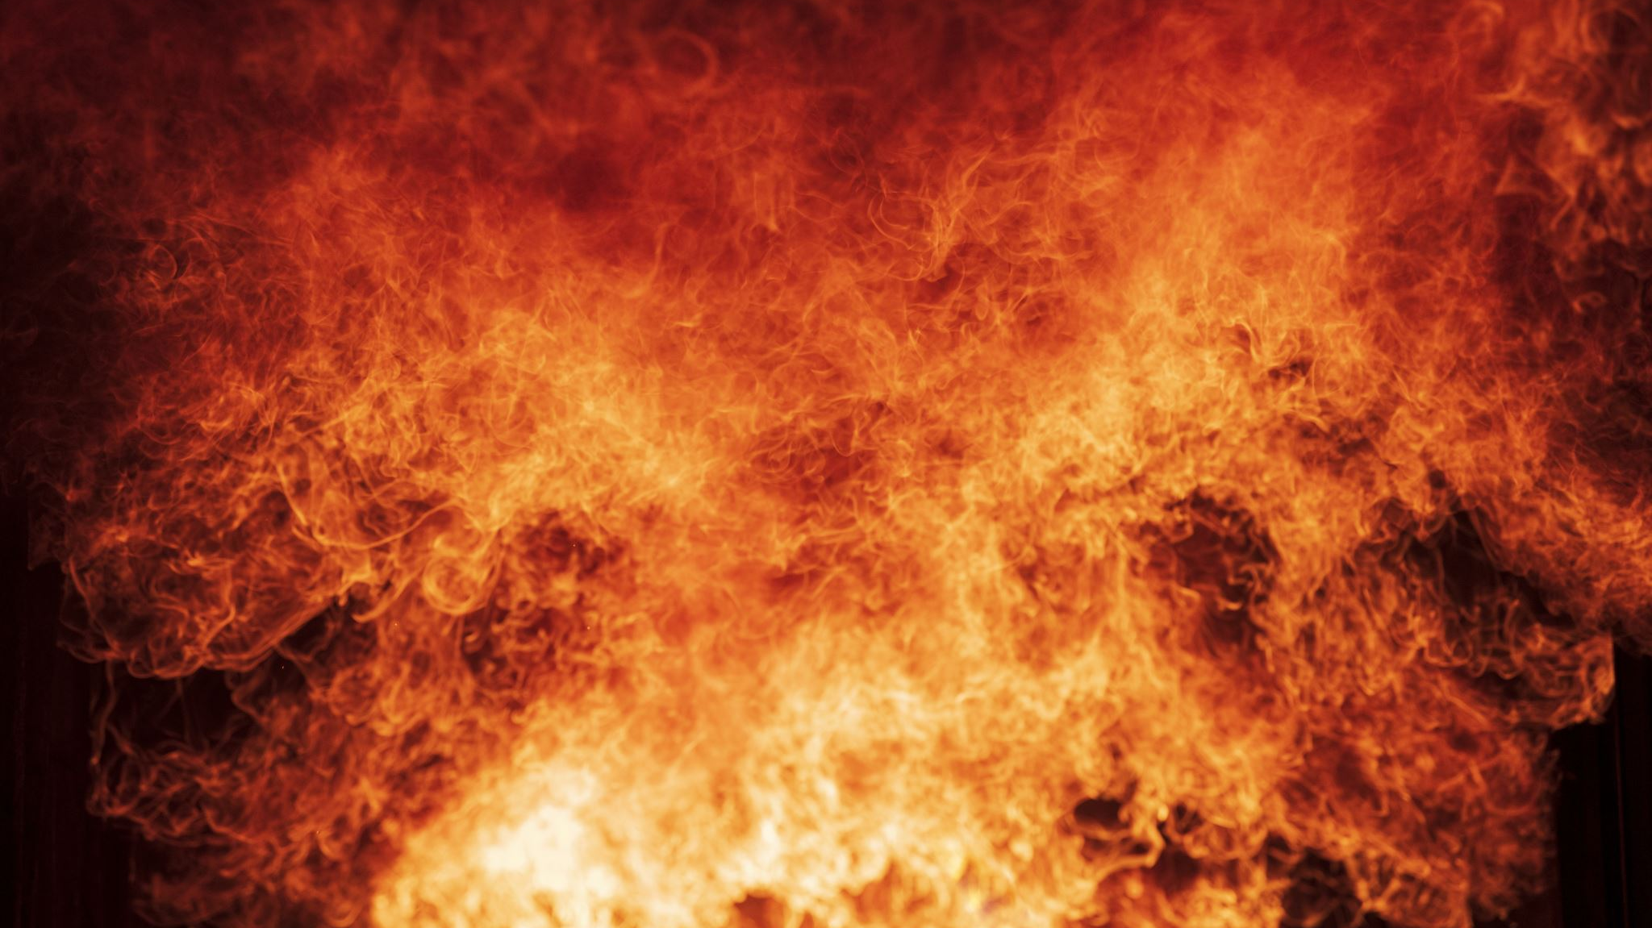
Burnout
Notes:
Burnout is the result of living in a high stress for extended period of time.

Slide 11
Signs of Burnout
Exhaustion
Detachment
Lack of Concentration
Self Medicating
No Work/Life Balance
Relationships in Trouble
Always Stressed

Slide 12
Why do lawyers burnout?
High achieving personality
Excessive Hours/Full Schedule
Professional Culture of “Toughing it Out”
Lack of Support
Notes:
Burnout is the result of living in a high stress for extended period of time.
Bloomberg 2022, lawyers felt burnout 52% of the time.

Slide 13
What happens to our practice if we do not work through stress?
Notes:
Loss of executive function. What is executive function.
Stress is thus thought to reallocate finite executive control resources to deal with the stressor at hand; cognitive resources normally devoted to working memory and cognitive flexibility would be funneled to selective attention (i.e., inhibition) in order to enhance the ability to focus on the current stressor.

Slide 14
What is Executive Function?
Working Memory: Allows a person to retain and store Information for future use. Useful for making sense of information, ordering information, relating information.
Notes:
Explain Executive Function- allows to plan out projects, tasks; flexibility, memory. Shows up in students and lawyers in project planning, focus
https://developingchild.harvard.edu/science/deep-dives/adult-capabilities/
https://manhattanpsychologygroup.com/executive-functioning-problems-adults/
Analyze a task
Plan how to take on the task
Organize the steps required to carry out the task
Create timelines for completing the task
Use flexibility to adjust for changes if needed to complete the task
Complete a task in a timely fashion and/or meet a deadline

Slide 15
What is Executive Function?
Flexible Thinking: Is the ability to problem solve and adapt to new situations.

Slide 16
What is Executive Function?
Inhibitory Control: Impulse control keeps a person from reacting or acting without thinking, while emotional control helps a person to remain calm and resist the urge to overreact or shutdown due to criticism or obstacles.

Slide 17
Stress Response Cycle
Notes:
We don’t want this to happen. To manage secondary trauma and prevent burnout, we need to complete the stress response cycle. Draw heavily form the book Burnout, The Secret to Unlocking the Stress Cycle.
Out. Run from bear. Come back:
Your community hugs you
You cry
Bear feast! – Literal fruits of labor
Dance party into the night
Tell the story, others watch, raptured. True connection, share emotion.
Burnout,The Secret to Unlocking the Stress Cycle, Emily Nagoski, PHD, Amelia Nagoski, DMA

Slide 18
We don’t battle with bears. (Our Modern-Day Stressors)
Notes:
We battle with annoying coworkers, traffic, political ads, demanding clients, clients experiencing incarceration, illness, family separation…
When we slay the bear in these situations, we rarely have the celebration. We don’t complete the stress response cycle.

Slide 19
Moving through stress
Stress has a
beginning,
A middle
and end.
Notes:
Identify that we are feeling stress
Name it as stress and name the source
Deal with it
I remember reading Emily and Amelia Nogoski’s book called Burnout. It talks about how healthy people move through stress. According to research, our emotions go through phases, having a beginning, middle and end. The authors use the metaphor of emotions passing through a tunnel, getting to the other side where they are resolved.

Slide 20
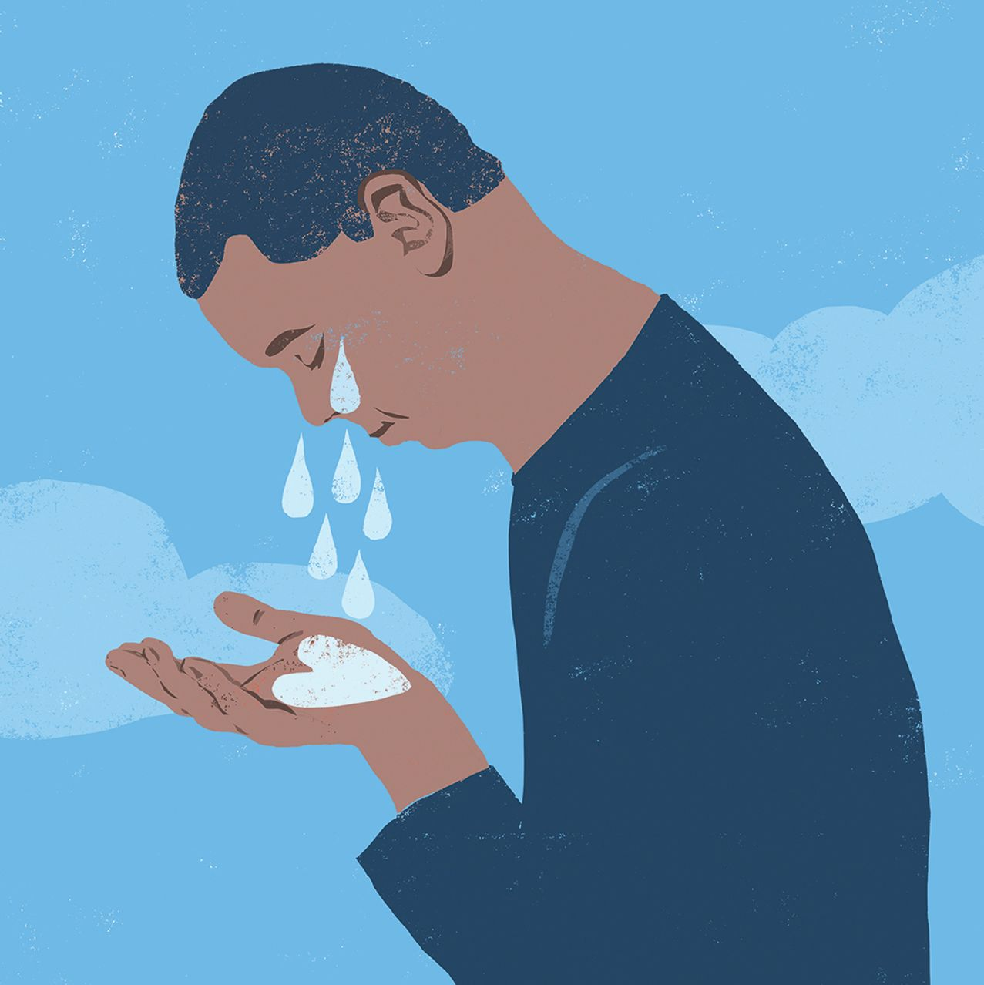
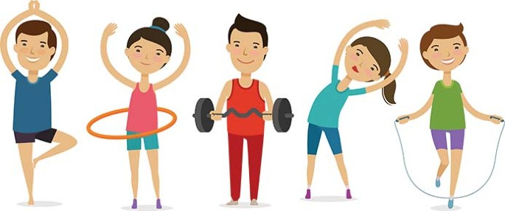
Just because you have dealt with the Stressor, doesn’t mean you have dealt with the Stress

Slide 21
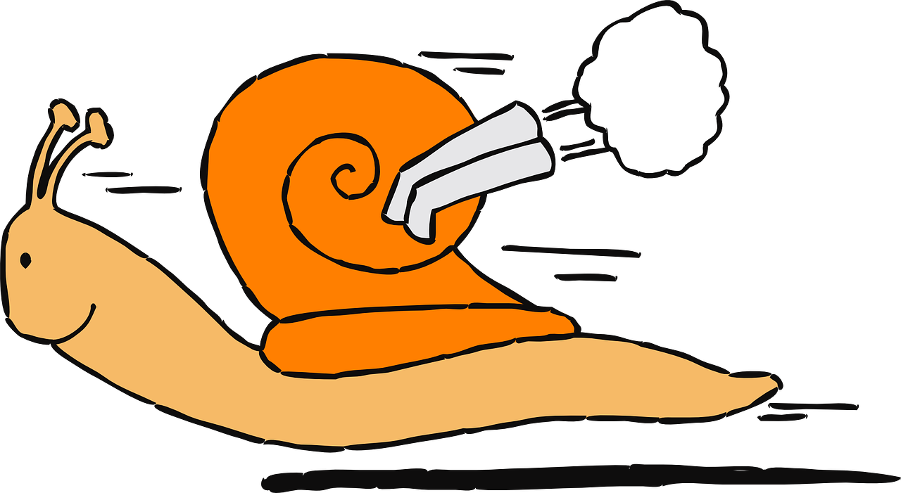
But what about the STRESS?!
Healthy people move through stress.
Notes:
When I talked about the bear.
Your community hugs you
You cry
Bear feast! – Literal fruits of labor
Dance party into the night
Tell the story, others watch, raptured. True connection, share emotion.
Physical activity
A good cry (What is your crying movie/book/song)
Affection – 6 second kiss, 20 second hug
Laughter
Creative Self Expression (Writing, Drawing, Singing)
Talking/Yelling/Crying it out
Coming together with your people

Slide 23
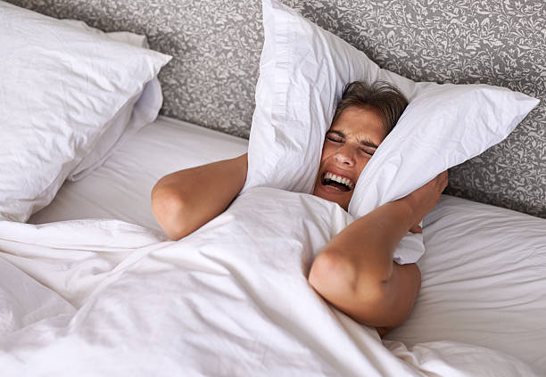

Slide 24
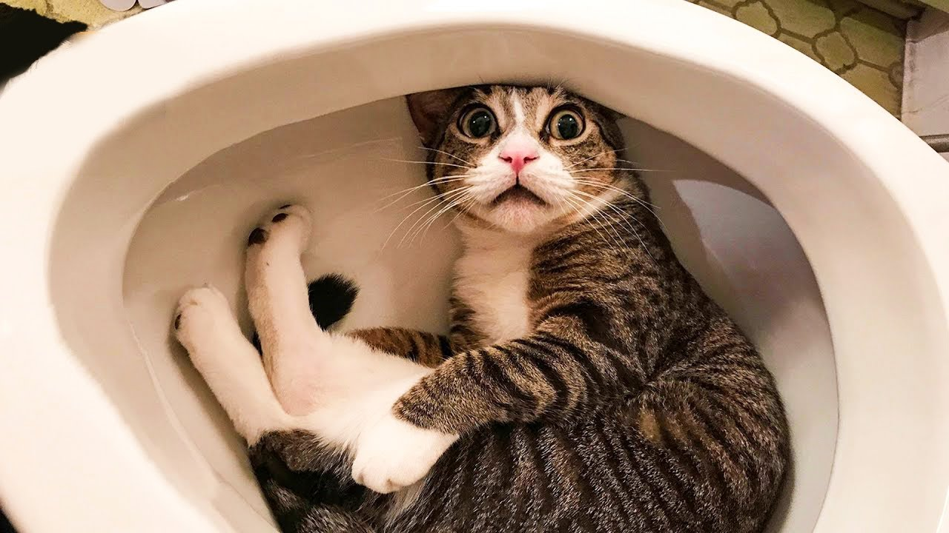
Notes:
Did you know dogs can’t be radiologists? But catscan.
What do you call cheese that isn’t yours? Nacho cheese
A grasshopper walks into a bar. Bartenders says, ‘hey, we have a drink named after you!” and the grasshopper says ‘you have a drink named Steve?”

Slide 25
Physical Activity

Slide 27
Physical Affection
Have someone you feel safe with to give you a long, strong hug (about 20 seconds according to the research). Affection – 6 second kiss, 20 second hug
Physical affection helps your body release trust and bonding hormones like oxytocin, and those can chase away the sense of danger your body was previously holding onto. As our hormones shift, our heart rate slows and our body begins to feel safe.
Notes:
https://hr.uky.edu/thrive/11-17-2020/completing-our-bodys-stress-re
sponse-cycle#:~:text=Here's%20a%20simple%20one%3A%20breathe,%2Dor%2Dflight%20stress%20response.

Slide 29
Activity
What are ways you would like to complete your stress response cycle?
Notes:
Physical activity
Move Heavy items in house
Clean
Plank Hold a plank for a minute. “This flexes your core muscles, which does two important things,” says Tarr. “One thing it does is force diaphragmatic breathing, which sends a signal to your brain to stop producing stress hormones like cortisol. The second thing it does is it can help keep your spine, neck and back healthy if you sit at a desk all day.”
A good cry (What is your crying movie/book/song)
Affection – 6 second kiss, 20 second hug
Laughter
Creative Self Expression (Writing, Drawing, Singing)
Talking/Yelling/Crying it out
Coming together with your people
Write an angry letter
Nap
When I talked about the bear.
Your community hugs you
You cry
Bear feast! – Literal fruits of labor
Dance party into the night
Tell the story, others watch, raptured. True connection, share emotion.

Slide 30
Wellness
"Wellness is not a state of being—it’s a state of action. It is the freedom to oscillate through the cycles of being human. Real-world wellness is messy, complicated, and not always accessible. If you sometimes feel overwhelmed and exhausted, that doesn’t mean you’re doing it wrong; it just means you’re moving through the process. Grant your body permission to be imperfect and listen to your own experience." - Drs. Amelia and Emily Nagoski, "Burnout."

Slide 31
Life
Identify People, Particularly Co-Workers that you can process with
Love your network
Incorporate hobbies that complete the stress response cycle

Slide 32
Modern Business Structures and Cultures in Law and Completing the Stress Cycle
Challenging
Helpful
Hourly Billing
Contingency Fees
Eat-What-You- Kill
Client Centered and Trauma Informed Lawyering
Flat Fee
Base Salary
Limited Scope
Client Centered and Trauma Informed Lawyering

Slide 33
Year
What are the natural cycles?
Quiet time to create efficiencies allowing you time to process
What are your goals?
Can you use data?
Caseload variation

Slide 34
How are we reducing the stressors? (EACO)
Eliminate
Close case, Reduce Caseload
Avoid
People, Situations, Activities (Social Media, News)
Change
Change Caseload Type, Job, City
Organize
Get your Life Together

Slide 35
Day/Week
Strategically plan your calendar to allow for time to complete the stress response cycle
Limit work to distinct hours (email starts that stress response all over again)
Make time to be supportive of colleagues
Notes:
Self Care
Processing Time (Start, End)

Slide 36
Activity
What are ways you can alter your life/practice to allow for completing the stress response cycle?

Slide 37
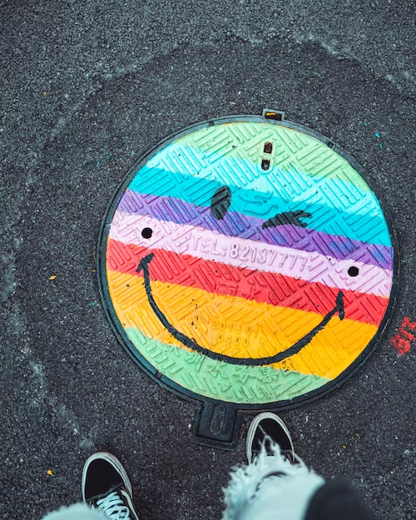
Happy Lawyering!
Erin E. Lee Schneider
Assistant Dean for Student Services
Drake University Law School
Erin.schneider@drake.edu

